Slide 1
W4111 – Introduction to Databases Lecture 11: Module II (4), NoSQL (4)
© Donald F. Ferguson, 2024

Slide 2

Contents
2 | W4111-2024F-11-HW3b4b-Normalization-ModuleIV © Donald F. Ferguson, 2024

Slide 3
Contents
Database design considerations:
Normalization simpler explanation and some worked examples.
Wide-flat versus normalization tradeoff and example.
Module II – Transaction and recovery:
Concepts
Atomicity and Durability
Isolation
Scalability and Availability
Data Enabled Decision Support
Overview
Enterprise Information Integration, Extract Transform Load, Data Lake, Data Warehouse
OLAP
HW 3a, 3b and Project
Overview
REST
Some examples
Reference/Backup Material

Slide 4
Module II Reminder
4 | W4111-2024F-11-HW3b4b-Normalization-ModuleIV © Donald F. Ferguson, 2024

Slide 5

Data Management
Previously
Load/save things quickly.
Storage Mgmt. (cont)
Access data quickly.
Find things quickly (cont).
Query processing, e.g. transform
Declarative language to
Procedural, functional, execution control
Today’s topics:
Transactions
Recovery
Database Systems: The Complete Book (2nd Edition) by Hector Garcia-Molina (Author), Jeffrey D. Ullman (Author), Jennifer Widom (Author)

Slide 6
Database Design Considerations
6 | W4111-2024F-11-HW3b4b-Normalization-ModuleIV © Donald F. Ferguson, 2024

Slide 7

Normalization Simplified
7 | W4111-2024F-11-HW3b4b-Normalization-ModuleIV © Donald F. Ferguson, 2024

Slide 8
Ferguson’s Laws of Teaching Databases
First Law: “There is no database concept so simple that database textbooks and course material cannot make the concept baffling and incomprehensible.”
Second Law: “No matter how baffling and incomprehensible a textbook or course material has made a simple concept, the course material will enhance the bewilderment by using unintelligible, confusing notation and quasi-math.”
My girlfriend saw this slide and added a 3rd Law.
Third Law: “The grumpy professor will inevitably make the concept terrifying in addition to baffling and incomprehensible.”

Slide 9
Goals of Normalization
Let R be a relation scheme with a set F of functional dependencies.
Decide whether a relation scheme R is in “good” form.
In the case that a relation scheme R is not in “good” form, need to decompose it into a set of relation scheme {R₁, R₂, ..., R_{n}} such that:
Each relation scheme is in good form
The decomposition is a lossless decomposition
Preferably, the decomposition should be dependency preserving.
DFF says, in a nutshell,
There are a few simple patterns to look for and fix.
Use common sense.

Slide 10
Denormalization for Performance
May want to use non-normalized schema for performance
For example, displaying prereqs along with course_id, and title requires join of course with prereq
Alternative 1: Use denormalized relation containing attributes of course as well as prereq with all above attributes
faster lookup
extra space and extra execution time for updates
extra coding work for programmer and possibility of error in extra code
Alternative 2: use a materialized view defined a course prereq
Benefits and drawbacks same as above, except no extra coding work for programmer and avoids possible errors

Slide 11
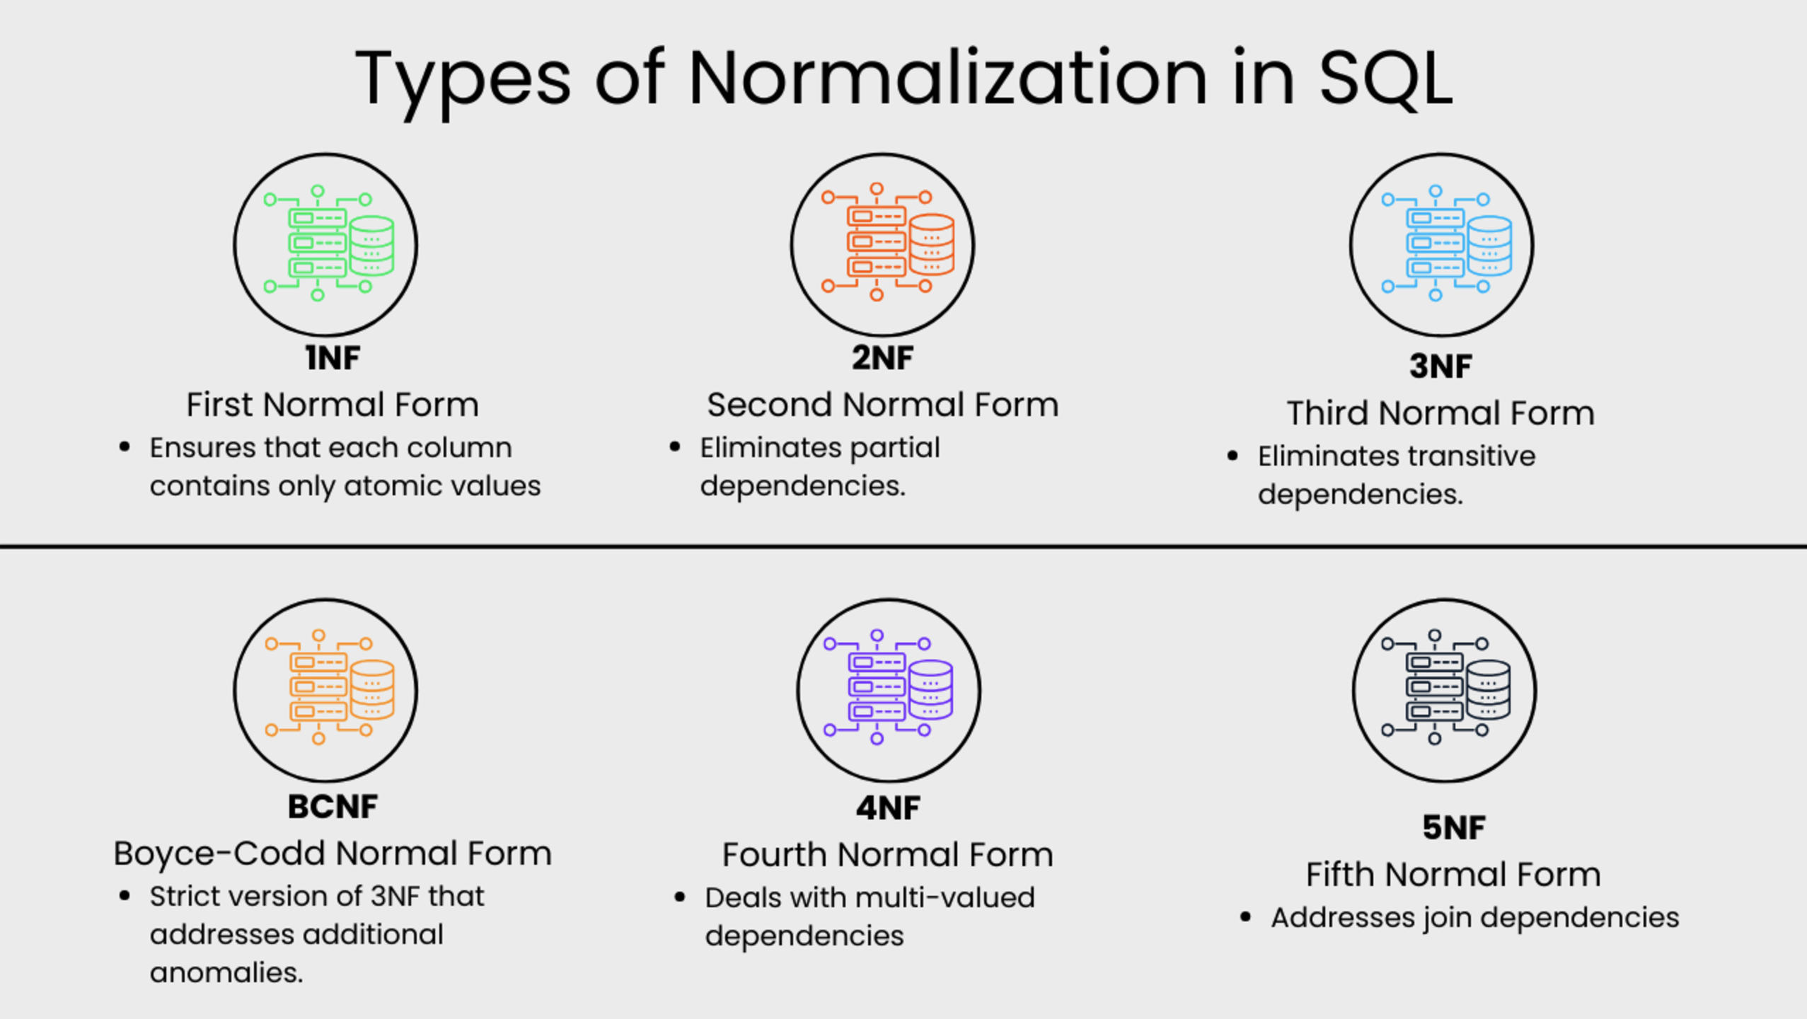
Simple Explanations
There are many good examples and tutorials on the web, e.g. https://www.datacamp.com/tutorial/normalization-in-sql

Slide 12
Simple Explanations
There are a lot of good, simple, short explanations and tutorials on the web.
First Normal Form (1NF)
This normalization level ensures that each column in your data contains only atomic values. Atomic values in this context means that each entry in a column is indivisible. It is like saying that each cell in a spreadsheet should hold just one piece of information. 1NF ensures atomicity of data, with each column cell containing only a single value and each column having unique names.
Second Normal Form (2NF)
Eliminates partial dependencies by ensuring that non-key attributes depend only on the primary key. What this means, in essence, is that there should be a direct relationship between each column and the primary key, and not between other columns.
Third Normal Form (3NF)
Removes transitive dependencies by ensuring that non-key attributes depend only on the primary key. This level of normalization builds on 2NF.
Boyce-Codd Normal Form (BCNF)
This is a more strict version of 3NF that addresses additional anomalies. At this normalization level, every determinant is a candidate key.
Fourth Normal Form (4NF)
This is a normalization level that builds on BCNF by dealing with multi-valued dependencies.
Fifth Normal Form (5NF)
5NF is the highest normalization level that addresses join dependencies. It is used in specific scenarios to further minimize redundancy by breaking a table into smaller tables.

Slide 13
Wide-Flat versus Normalization
13 | W4111-2024F-11-HW3b4b-Normalization-ModuleIV © Donald F. Ferguson, 2024

Slide 14
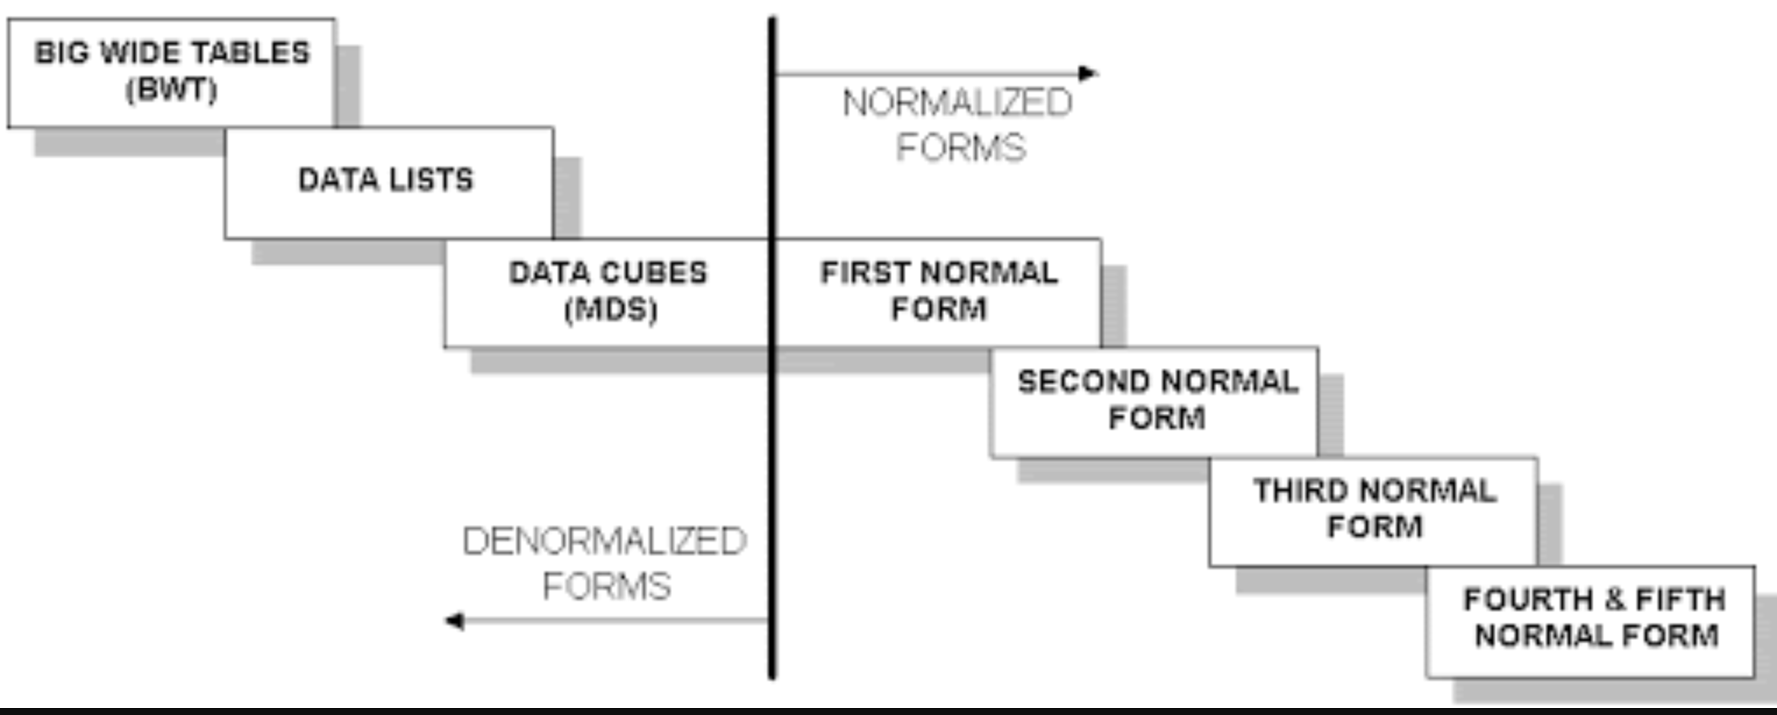
Wide Flat Tables
Good for Integrity
Good for Query
Improve query performance by precomputing and saving:
JOINs
Aggregation
Derived/computed columns
One of the primary strength of the relational model is maintaining “integrity” when applications create, update and delete data. This relies on:
The core capabilities of the relational model, e.g. constraints.
A well-design database (We will cover a formal definition – “normalization” in more detail later.
Data models that are well designed for integrity are very bad for read only analysis queries. We will build and analyze wide flat tables as part of the analysis tasks in HW3, HW4 as projects.

Slide 15
Transactions and Recovery
15 | W4111-2024F-11-HW3b4b-Normalization-ModuleIV © Donald F. Ferguson, 2024

Slide 16
Core Concepts
16 | W4111-2024F-11-HW3b4b-Normalization-ModuleIV © Donald F. Ferguson, 2024

Slide 17
Core Transaction Concept is ACID Properties
http://slideplayer.com/slide/9307681
ACID
Atomic
“ALL OR NOTHING”
Transaction cannot be subdivided
Consistent
Transaction → transforms database from one consistent state to another consistent state
Isolated
Transactions execute independently of one another
Database changes not revealed to users until after transaction has completed
Durable
Database changes are permanent
The permanence of the database’s consistent state

Slide 18
ACID Properties (httpwww.tutorialspoint.com/dbms/dbms_transaction.htm)
A transaction is a very small unit of a program and it may contain several low-level tasks. A transaction in a database system must maintain Atomicity, Consistency, Isolation, and Durability − commonly known as ACID properties − in order to ensure accuracy, completeness, and data integrity.
Atomicity − This property states that a transaction must be treated as an atomic unit, that is, either all of its operations are executed or none. There must be no state in a database where a transaction is left partially completed. States should be defined either before the execution of the transaction or after the execution/abortion/failure of the transaction.
Consistency − The database must remain in a consistent state after any transaction. No transaction should have any adverse effect on the data residing in the database. If the database was in a consistent state before the execution of a transaction, it must remain consistent after the execution of the transaction as well.
Durability − The database should be durable enough to hold all its latest updates even if the system fails or restarts. If a transaction updates a chunk of data in a database and commits, then the database will hold the modified data. If a transaction commits but the system fails before the data could be written on to the disk, then that data will be updated once the system springs back into action.
Isolation − In a database system where more than one transaction are being executed simultaneously and in parallel, the property of isolation states that all the transactions will be carried out and executed as if it is the only transaction in the system. No transaction will affect the existence of any other transaction.

Slide 19
Transaction Concept
A transaction is a unit of program execution that accesses and possibly updates various data items.
E.g., transaction to transfer $50 from account A to account B:
BEGIN TRANSACTION {
1. read(A)
2. A := A – 50
write(A)
4. read(B)
5. B := B + 50
write(B)
COMMIT or ROLLBACK }
Two main issues to deal with:
Failures of various kinds, such as hardware failures and system crashes
Concurrent execution of multiple transactions
BEGIN TRANSACTION {
1. read(A)
2. A := A – 50
write(A)
4. read(B)
5. B := B + 50
write(B)
COMMIT or ROLLBACK }

Slide 20
Example of Fund Transfer
T
Transaction to transfer $50 from account A to account B:
1. read(A)
2. A := A – 50
3. write(A)
4. read(B)
5. B := B + 50
6. write(B)
Atomicity requirement
If the transaction fails after step 3 and before step 6, money will be “lost” leading to an inconsistent database state
Failure could be due to software or hardware
The system should ensure that updates of a partially executed transaction are not reflected in the database
Durability requirement — once the user has been notified that the transaction has completed (i.e., the transfer of the $50 has taken place), the updates to the database by the transaction must persist even if there are software or hardware failures.
B
C

Slide 21
Example of Fund Transfer (Cont.)
Consistency requirement in above example:
The sum of A and B is unchanged by the execution of the transaction
In general, consistency requirements include
Explicitly specified integrity constraints such as primary keys and foreign keys
Implicit integrity constraints
e.g., sum of balances of all accounts, minus sum of loan amounts must equal value of cash-in-hand
A transaction must see a consistent database.
During transaction execution the database may be temporarily inconsistent.
When the transaction completes successfully the database must be consistent
Erroneous transaction logic can lead to inconsistency

Slide 22
Example of Fund Transfer (Cont.)
Isolation requirement — if between steps 3 and 6, another transaction T2 is allowed to access the partially updated database, it will see an inconsistent database (the sum A + B will be less than it should be).
T1 T2
1. read(A)
2. A := A – 50
write(A) read(A)
read(B) print(A+B)
4. read(B)
5. B := B + 50
6. write(B)
Isolation can be ensured trivially by running transactions serially
That is, one after the other.
However, executing multiple transactions concurrently has significant benefits, as we will see later.
T1, T2
T1
T2

Slide 23
ACID Properties
A transaction is a unit of program execution that accesses and possibly updates various data items. To preserve the integrity of data the database system must ensure:
Atomicity. Either all operations of the transaction are properly reflected in the database or none are.
Consistency. Execution of a transaction in isolation preserves the consistency of the database.
Isolation. Although multiple transactions may execute concurrently, each transaction must be unaware of other concurrently executing transactions. Intermediate transaction results must be hidden from other concurrently executed transactions.
That is, for every pair of transactions T_{i} and T_{j}, it appears to T_{i} that either T_{j}, finished execution before T_{i} started, or T_{j} started execution after T_{i} finished.
Durability. After a transaction completes successfully, the changes it has made to the database persist, even if there are system failures.

Slide 24
Transaction State
Active – the initial state; the transaction stays in this state while it is executing
Partially committed – after the final statement has been executed.
Failed -- after the discovery that normal execution can no longer proceed.
Aborted – after the transaction has been rolled back and the database restored to its state prior to the start of the transaction. Two options after it has been aborted:
Restart the transaction
Can be done only if no internal logical error
Kill the transaction
Committed – after successful completion.

Slide 25
Atomicity Durability
25 | W4111-2024F-11-HW3b4b-Normalization-ModuleIV © Donald F. Ferguson, 2024

Slide 26
Atomicity
A transaction is a logical unit of work that must be either entirely completed or entirely undone. (All writes happen or none of them happen)
OK. What does this mean? Consider some pseudo-code
def transfer(source_acct_id, target_acct_id, amount)
Check that both accounts exist.
IF is_checking_account(source_acct_id)
Check that (source_acct.balance-amount) > source_account.overdraft_limit
ELSE
Check that (source_count.balance-amount) >source_account.minimum_balance
Update source account
Update target account.
INSERT a record into transfer tracking table.

Slide 27
Atomicity
A transaction is a logical unit of work that must be either entirely completed or entirely undone. (All writes happen or none of them happen)
OK. What does this mean? Consider some pseudo-code
def transfer(source_acct_id, target_acct_id, amount)
Check that both accounts exist.
IF is_checking_account(source_acct_id)
Check that (source_acct.balance-amount) > source_account.overdraft_limit
ELSE
Check that (source_count.balance-amount) >source_account.minimum_balance
Update source account
Update target account.
INSERT a record into transfer tracking table.
Computer or DB Server fails.

Slide 28
Atomicty
Transaction programs and databases are fast (milliseconds). What are the chances of the failure occurring in the wrong spot?
Well, that doesn’t really matter. If it happens,
Someone lost money and
There is no record off it. Someone is going to very upset.
Even a small server can have thousands of concurrent transactions ➔
There will be corruptions because some transaction will be in the wrong place at the wrong time.
Unless we do something in the DBMS
Because HW and software inevitably fail
And sadly, SW is especially prone to failure when under load

Slide 29
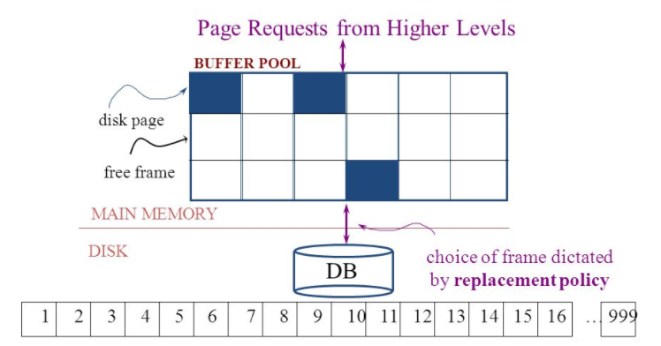
Simplistic Approach
Begin
Update A
Update B
Update C
Commit (REQ)
Force to disk
Commit (RSP)

Slide 30
Simplistic Approach
There are several problems with the simplistic approach.
The approach does not solve the problem
Some writes might succeed.
Some might be interrupted by the failure, or require retry.
Writes may be random and scattered. N updates might
Change a few bytes in N data frames
A few bytes in M index frames
Transaction rate becomes bottlenecked by write I/O rate, even though a relative small number of bytes change/transaction.
Written frames must be held in memory.
Lots of transactions
Randomly writing small pieces of lots of frames.
Consumes lots of memory with pinned pages.
Degrades the performance and optimization of the buffer.
The optimal buffer replacement policy wants to hold frames that will be reused.
Not frames that have been touched and never reused.

Slide 31
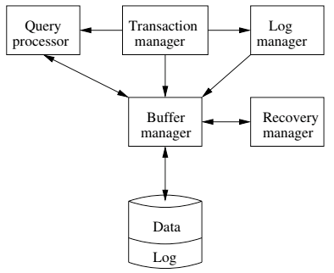
DBMS ACID Implementation
Implementation Subsystems
Query processor schedules and executes queries.
Buffer manager controls reading/writing blocks/frames to/from disk.
Log manager journals/records events to disk (log), e.g.
Transaction start/commit/abort
Transaction update of a block and previous value of data.
Transaction manager coordinates query scheduling, buffer read/write and logging to ensure ACID.
Recovery manager processes log to ensure ACID even after transaction or system failures.
Log is a special type of block file used by the system to optimize performance and ensure ACID.
Garcia-Molina et al., p. 846

Slide 32
Logging
The DBMS logs every transaction event
Log Sequence Number (LSN): A unique ID for a log record.
Prev LSN: A link to their last log record.
Transaction ID number.
Type: Describes the type of database log record.
Update Log Record
PageID: A reference to the Page ID of the modified page.
Length and Offset: Length in bytes and offset of the page are usually included.
Before and After Images of records.
Compensation Log Record
Commit Record
Abort Record Checkpoint Record
Completion Record notes that all work has been done for this particular transaction.

Slide 33
Write Ahead Logging
DBMS (Redo processing)
Write log events from all transactions into a single log stream.
Multiple events per page
Forces (writes) log record on COMMIT/ABORT
Single block I/O records many updates
Versus multiple block I/Os, each recording a single change.
All of a transaction’s updates recorded in one I/O versus many.
If there is a failure
DBMS sequentially reads log.
Applies changes to modified pages that were not saved to disk.
Then resumes normal processing.
Begin
Update A
Update B
Update C
Commit (REQ)
Force to disk
Commit (RSP)
Log

Slide 34
Write Ahead Logging
Force every write to disk?
Poor response time.
But provides durability.
Steal buffer-pool frames from uncommitted transactions?
If not, poor performance/caching performance
If yes, how can we ensure atomicity? Uncommitted updates on disk
DBMS (Undo processing)
Enable steal policy to improve cache performance by
Avoiding lots of pinned pages
Unlikely to be reused soon.
Before stealing
Force log record to disk.
Update log entry has data record
Before image
After image
If there is a failure
DBMS sequentially reads log.
Undoes changes to
modified pages, uncommitted pages
That were saved to disk.
Then resumes normal processing.
No Steal
Steal
Force
Trivial
No Force
Desired

Slide 35
ARIES Algorithm = Algorithms for Recovery and Isolation Exploiting Semantics
ARIES recovery involves three passes
Analysis pass:
Determine which transactions to undo
Determine which pages were dirty (disk version not up to date) at time of
RedoLSN: LSN from which redo should start
Redo pass:
Repeats history, redoing all actions from RedoLSN (updated committed but not written changes to pages)
RecLSN and PageLSNs are used to avoid redoing actions already reflected on page
Undo pass:
Rolls back all incomplete transactions (with uncommitted pages written to disk).
Transactions whose abort was complete earlier are not undone

Slide 36
Durability
Write changes to disk trivially achieves durability.
DBMS engine uses write-ahead-logging to
Achieve durability
But with better performance through more efficient caching and I/O.
Well, disks fail. How is that durable.
RAID and other solutions.
Disk subsystems, including entire RAID device, fail →
Duplex writes
To independent disk subsystems.
Well, there are earthquakes, floods, etc.

Slide 37
Availability and Replication
There are two basic patterns
Active/Passive
All requests go to master during normal processing.
Updates are transactionally queued for processing at passive backup.
Failure of master
Routes subsequent requests to backup.
Backup must process and commit updates before accepting requests.
Active/Active
Both environments process requests.
Some form of distributed transaction commit required to synchronize updates on both copies.
Multi-system communication to guarantee consistency is the foundation for tradeoffs in CAP.
The system can be CAP if and only iff
There are never any partitions or system failures
Which is unrealistic in cloud/Internet systems.

Slide 38
Isolation
38 | W4111-2024F-11-HW3b4b-Normalization-ModuleIV © Donald F. Ferguson, 2024

Slide 39
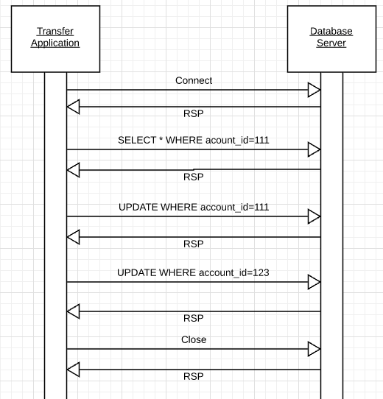
Isolation
Transfer $50 from
account_id=111 to
account_id=123
Requires 3 SQL statements
SELECT from 111 to check balance >= $50
UPDATE account_id=111
UPDATE account_id=123
There are some interesting scenarios
Two different programs read the balance ($51)
And decide removing $50 is OK.
DB constraints can prevent the conflict from happening, but …
There are more complex scenarios that constraints do not prevent.
Not ALL databases support constraints.
The “correct” execution should be that
One transaction responds “insufficient funds”
Before attempting transfer instead of after attempting.
Multiple readers

Slide 40
Isolation
Consider two simultaneous transfer transactions T1 and T2.
There are two equally correct executions
T1 transfers, T2 responds “insufficient funds” and does not attempt transfer
T2 transfers, T1 responds “insufficient funds” and does not attempt transfer
Each correct simultaneous execution is equivalent to a serial (sequential) execution schedule
(1) Execute T1, Execute T2
(2) Execute T2, Execute T1
NOTE:
We are focusing on correctness not
Fairness:
We do not care which transaction was actually submitted first.
And probably do not know due to networking, etc.
Transfer $50 from
account_id=111 to
account_id=123
Requires 3 SQL statements
SELECT from 111 to check balance >= $50
UPDATE account_id=111
UPDATE account_id=123
There are some interesting scenarios
Two different programs read the balance ($51)
And decide removing $50 is OK.
DB constraints can prevent the conflict from happening, but …
There are more complex scenarios that constraints do not prevent.
Not ALL databases support constraints.
The “correct” execution should be that
One transaction responds “insufficient funds”
Before attempting transfer instead of after attempting.
Multiple readers

Slide 41
Serializability
“In concurrency control of databases,^{[1][2]} transaction processing (transaction management), and various transactional applications (e.g., transactional memory^{[3]} and software transactional memory), both centralized and distributed, a transaction schedule is serializable if its outcome (e.g., the resulting database state) is equal to the outcome of its transactions executed serially, i.e. without overlapping in time. Transactions are normally executed concurrently (they overlap), since this is the most efficient way. Serializability is the major correctness criterion for concurrent transactions' executions. It is considered the highest level of isolation between transactions, and plays an essential role in concurrency control. As such it is supported in all general purpose database systems.” (https://en.wikipedia.org/wiki/Serializability)

Slide 42
DBMS ACID Implementation
Implementation Subsystems
Query processor schedules and executes queries.
Buffer manager controls reading/writing blocks/frames to/from disk.
Log manager journals/records events to disk (log), e.g.
Transaction start/commit/abort
Transaction update of a block and previous value of data.
Transaction manager coordinates query scheduling, buffer read/write and logging to ensure ACID.
Recovery manager processes log to ensure ACID even after transaction or system failures.
Log is a special type of block file used by the system to optimize performance and ensure ACID.
Garcia-Molina et al., p. 846

Slide 43
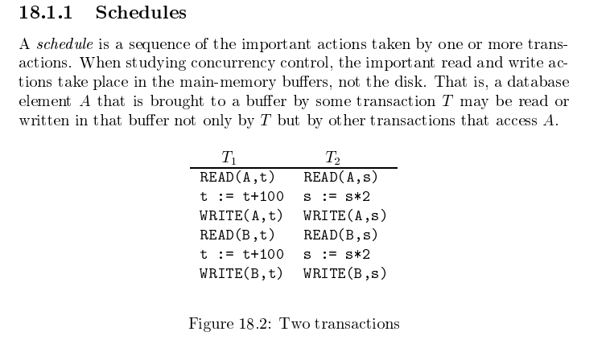
Schedule
Garcia-Molina et al.

Slide 44
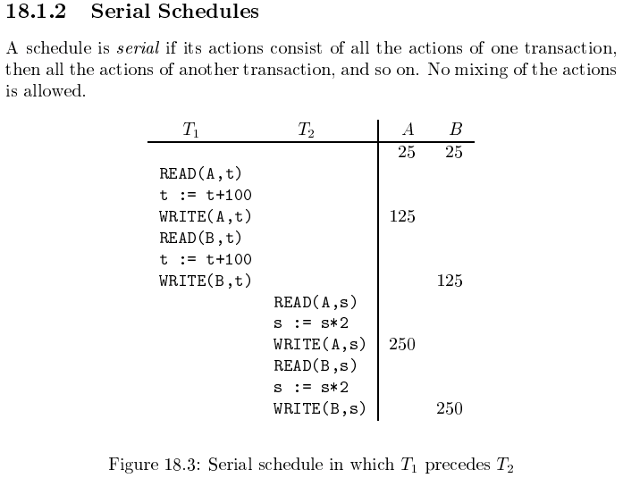
Serializable
Assume there are three
concurrently executing transactions
T1, T2 and T3
The transaction manager
Enables concurrent execution
But schedules individual operations
To ensure that the final DB state
Is equivalent to one of the following schedules
T1, T2, T3
T1, T3, T2
T2, T1, T3
T2, T3, T1
T3, T1, T2
T3, T2, T1
Concurrent execution was serializable.

Slide 45
Serializability (en.wikipedia.org/wiki/Serializability)
Serializability is used to keep the data in the data item in a consistent state. Serializability is a property of a transaction schedule (history). It relates to the isolation property of a database transaction.
Serializability of a schedule means equivalence (in the outcome, the database state, data values) to a serial schedule (i.e., sequential with no transaction overlap in time) with the same transactions. It is the major criterion for the correctness of concurrent transactions' schedule, and thus supported in all general purpose database systems.
The rationale behind serializability is the following:
If each transaction is correct by itself, i.e., meets certain integrity conditions,
then a schedule that comprises any serial execution of these transactions is correct (its transactions still meet their conditions):
"Serial" means that transactions do not overlap in time and cannot interfere with each other, i.e, complete isolation between each other exists.
Any order of the transactions is legitimate, (…)
As a result, a schedule that comprises any execution (not necessarily serial) that is equivalent (in its outcome) to any serial execution of these transactions, is correct.

Slide 46
Lock-Based Concurrency Control
Strict Two-phase Locking (Strict 2PL) Protocol:
Each Xact must obtain a S (shared) lock on object before reading, and an X (exclusive) lock on object before writing.
All locks held by a transaction are released when the transaction completes
(Non-strict) 2PL Variant: Release locks anytime, but cannot acquire locks after releasing any lock.
If an Xact holds an X lock on an object, no other Xact can get a lock (S or X) on that object.
Strict 2PL allows only serializable schedules.
Additionally, it simplifies transaction aborts
(Non-strict) 2PL also allows only serializable schedules, but involves more complex abort processing

Slide 47
Aborting a Transaction
If a transaction Ti is aborted, all its actions have to be undone. Not only that, if Tj reads an object last written by Ti, Tj must be aborted as well!
Most systems avoid such cascading aborts by releasing a transaction’s locks only at commit time.
If Ti writes an object, Tj can read this only after Ti commits.
In order to undo the actions of an aborted transaction, the DBMS maintains a log in which every write is recorded. This mechanism is also used to recover from system crashes: all active Xacts at the time of the crash are aborted when the system comes back up.

Slide 48
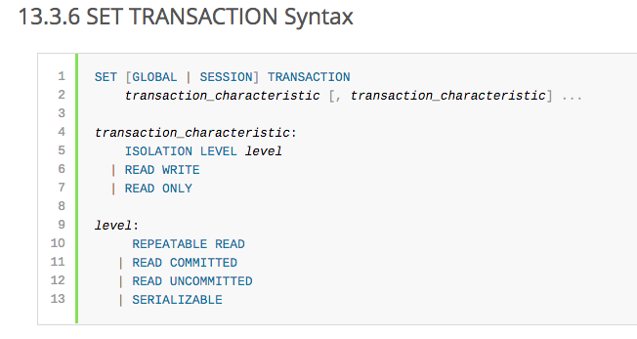
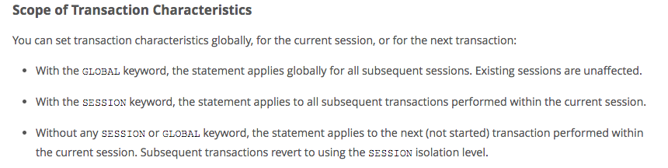
MySQL (Locking) Isolation

Slide 49
Isolation Levels (https://en.wikipedia.org/wiki/Isolation_(database_systems)
Not all transaction use cases require 2PL and serializable execution. Databases support a a set of levels.
Serializable
With a lock-based concurrency control DBMS implementation, serializability requires read and write locks (acquired on selected data) to be released at the end of the transaction. Also range-locks must be acquired when a SELECT query uses a ranged WHERE clause, especially to avoid the phantom reads phenomenon.
The execution of concurrent SQL-transactions at isolation level SERIALIZABLE is guaranteed to be serializable. A serializable execution is defined to be an execution of the operations of concurrently executing SQL-transactions that produces the same effect as some serial execution of those same SQL-transactions. A serial execution is one in which each SQL-transaction executes to completion before the next SQL-transaction begins.
Repeatable reads
In this isolation level, a lock-based concurrency control DBMS implementation keeps read and write locks (acquired on selected data) until the end of the transaction. However, range-locks are not managed, so phantom reads can occur.
Write skew is possible at this isolation level, a phenomenon where two writes are allowed to the same column(s) in a table by two different writers (who have previously read the columns they are updating), resulting in the column having data that is a mix of the two transactions.^{[3][4]}
Read committed
In this isolation level, a lock-based concurrency control DBMS implementation keeps write locks (acquired on selected data) until the end of the transaction, but read locks are released as soon as the SELECT operation is performed (so the non-repeatable reads phenomenon can occur in this isolation level). As in the previous level, range-locks are not managed.
Putting it in simpler words, read committed is an isolation level that guarantees that any data read is committed at the moment it is read. It simply restricts the reader from seeing any intermediate, uncommitted, 'dirty' read. It makes no promise whatsoever that if the transaction re-issues the read, it will find the same data; data is free to change after it is read.
Read uncommitted
This is the lowest isolation level. In this level, dirty reads are allowed, so one transaction may see not-yet-committed changes made by other transactions

Slide 50
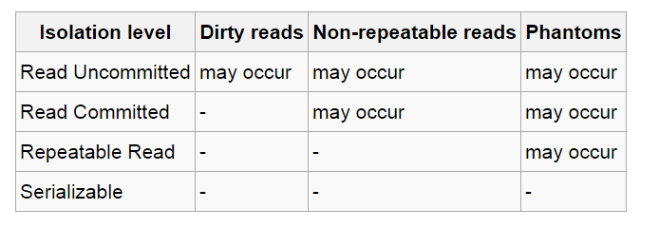
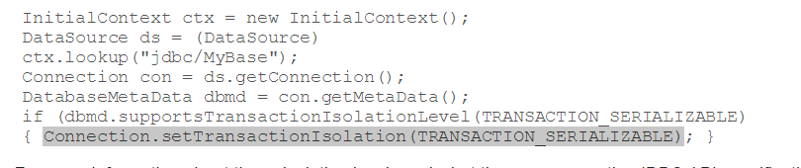
In Databases, Cursors Define Isolation
We have talked about ACID transactions
Atomic: A set of writes all occur or none occur.
Durable: The data “does not disappear,” e.g. write to disk.
Consistent: My applications move the database between consistent states, e.g. the transfer function works correctly.
Isolation
Determines what happens when two or more threads are manipulating the data at the same time.
And is defined relative to where cursors are and what they have touched.
Because the cursor movement determines what you are reading or have read.
But, … Cursors are client conversation state and cannot be used in REST.

Slide 51
Scalability Availability
51 | W4111-2024F-11-HW3b4b-Normalization-ModuleIV © Donald F. Ferguson, 2024

Slide 52
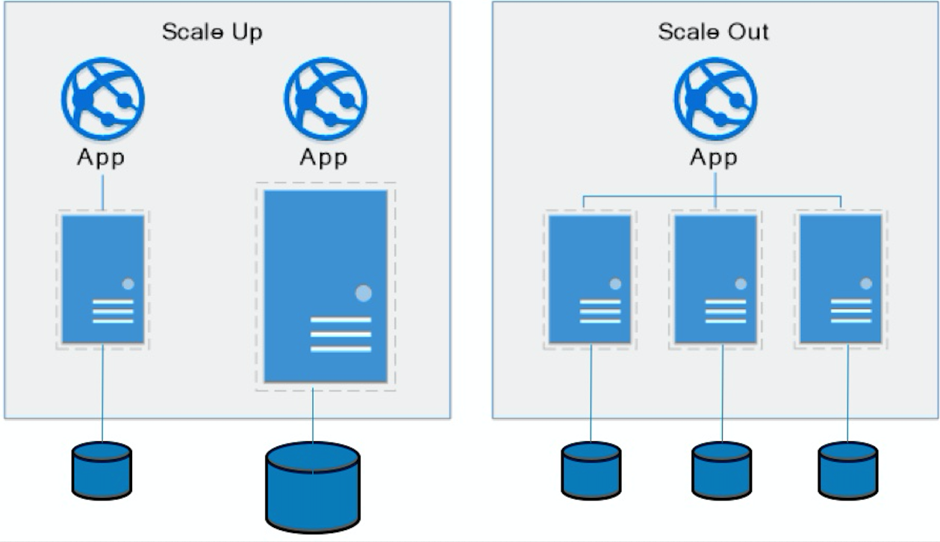
Approaches to Scalability
Scalability is the property of a system to handle a growing amount of work by adding resources to the system.
Replace system with a bigger machine, e.g. more memory, CPU, ... ...
Scale-up:
Less incremental.
More disruptive.
More expensive for extremely large systems.
Does not improve availability
Scale-out:
Incremental cost.
Data replication enables availability.
Does not work well for functions like JOIN, referential integrity, ... ...
Add another system.

Slide 53
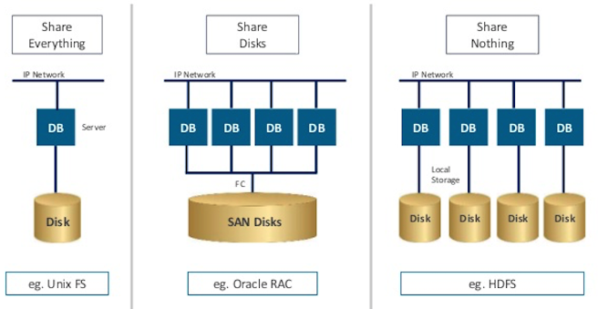
Disk Architecture for Scale-Out
Share disks:
Is basically scale-up for data/disks. You can use NAS, SAN and RAID.
Isolation/Integrity requires distributed locking to control access from multiple database servers.
Share nothing:
Is basically scale-out for disks.
Data is partitioned into shards based on a function f() applied to a key.
Can improve availability, at the code consistency, with data replication.
There is a router that sends requests to the proper shard based on the function.

Slide 54
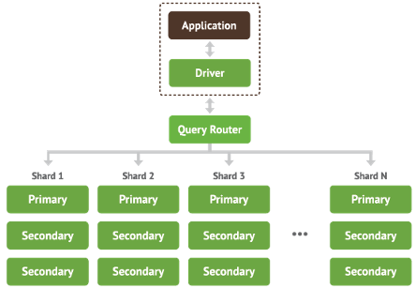
Shared Nothing, Scale-Out
MongoDB Sharding
DynamoDB Partitioning

Slide 55
Data Enablement Decision Support

Slide 56
Overview
Transactions Isolation Recovery

Slide 57
Overview
Data analytics: the processing of data to infer patterns, correlations, or models for prediction
Primarily used to make business decisions
Per individual customer
E.g., what product to suggest for purchase
Across all customers
E.g., what products to manufacture/stock, in what quantity
Critical for businesses today

Slide 58
Overview (Cont.)
Common steps in data analytics
Gather data from multiple sources into one location
Data warehouses also integrated data into common schema
Data often needs to be extracted from source formats, transformed to common schema, and loaded into the data warehouse
Can be done as ETL (extract-transform-load), or ELT (extract-load-transform)
Generate aggregates and reports summarizing data
Dashboards showing graphical charts/reports
Online analytical processing (OLAP) systems allow interactive querying
Statistical analysis using tools such as R/SAS/SPSS
Including extensions for parallel processing of big data
Build predictive models and use the models for decision making

Slide 59
Overview (Cont.)
Predictive models are widely used today
E.g., use customer profile features (e.g. income, age, gender, education, employment) and past history of a customer to predict likelihood of default on loan
and use prediction to make loan decision
E.g., use past history of sales (by season) to predict future sales
And use it to decide what/how much to produce/stock
And to target customers
Other examples of business decisions:
What items to stock?
What insurance premium to change?
To whom to send advertisements?

Slide 60
Overview (Cont.)
Machine learning techniques are key to finding patterns in data and making predictions
Data mining extends techniques developed by machine-learning communities to run them on very large datasets
The term business intelligence (BI) is synonym for data analytics
The term decision support focuses on reporting and aggregation

Slide 61
Enterprise Information Integration ETL
Data Warehouse, Data Lake
Transactions Isolation Recovery

Slide 62
Enterprise Information Integration

Slide 63
Data Warehouse and Data Lake

Slide 64
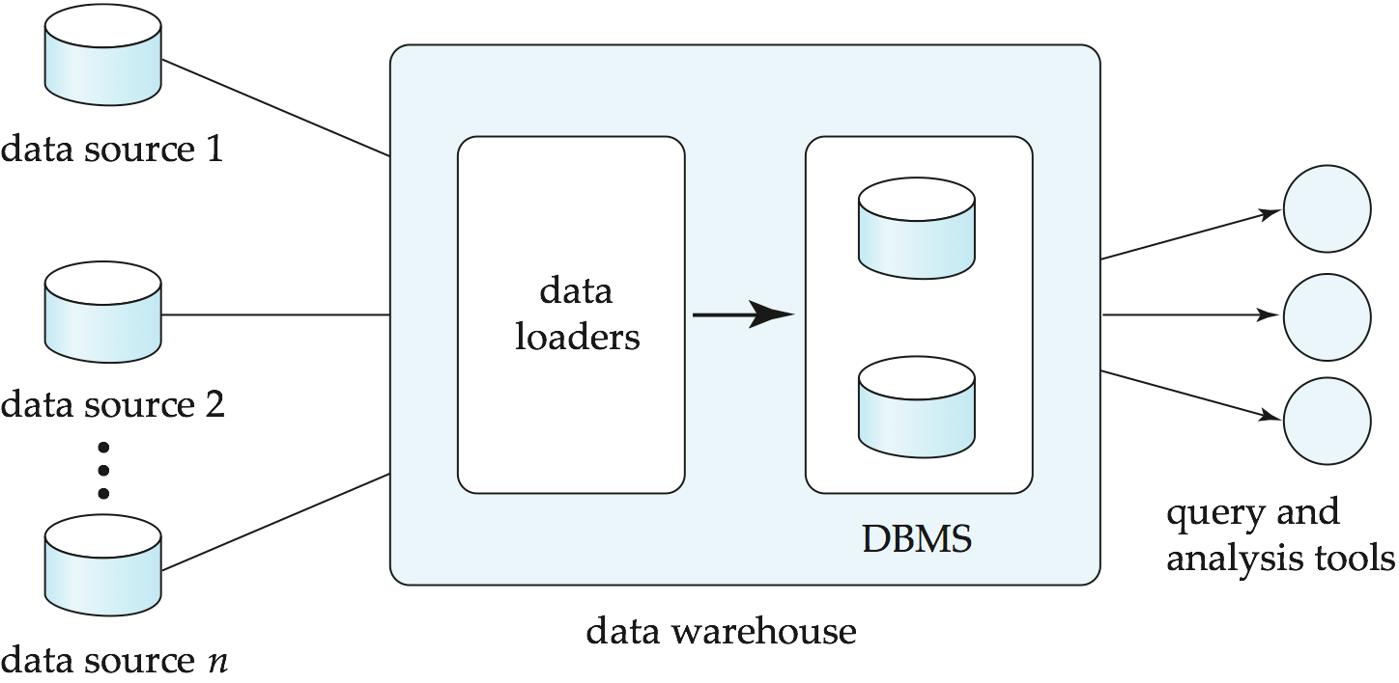
Data Warehousing

Slide 65
Overview (Cont.)
Common steps in data analytics
Gather data from multiple sources into one location
Data warehouses also integrated data into common schema
Data often needs to be extracted from source formats, transformed to common schema, and loaded into the data warehouse
Can be done as ETL (extract-transform-load), or ELT (extract-load-transform)
Generate aggregates and reports summarizing data
Dashboards showing graphical charts/reports
Online analytical processing (OLAP) systems allow interactive querying
Statistical analysis using tools such as R/SAS/SPSS
Including extensions for parallel processing of big data
Build predictive models and use the models for decision making

Slide 66
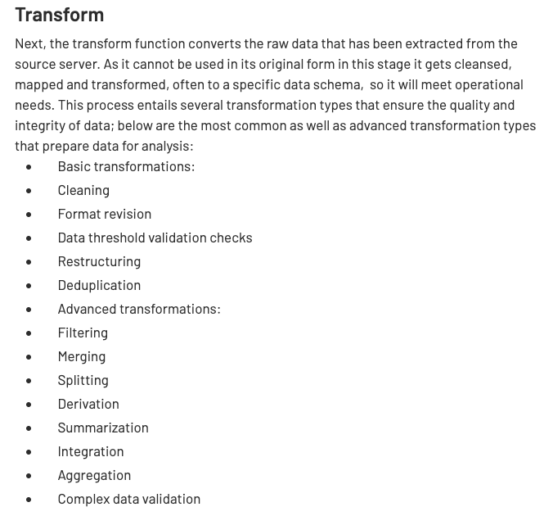
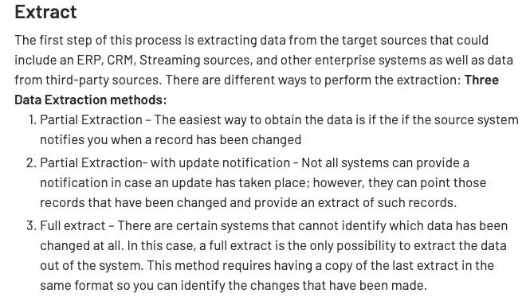
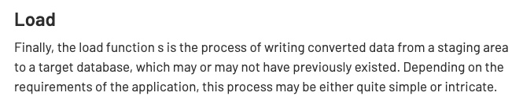
ETL Concepts
https://databricks.com/glossary/extract-transform-load

Slide 67
OLAP
67 | W4111-2024F-11-HW3b4b-Normalization-ModuleIV © Donald F. Ferguson, 2024

Slide 68
Data Analysis and OLAP
Online Analytical Processing (OLAP)
Interactive analysis of data, allowing data to be summarized and viewed in different ways in an online fashion (with negligible delay)
We use the following relation to illustrate OLAP concepts
sales (item_name, color, clothes_size, quantity)
This is a simplified version of the sales fact table joined with the dimension tables, and many attributes removed (and some renamed)

Slide 69
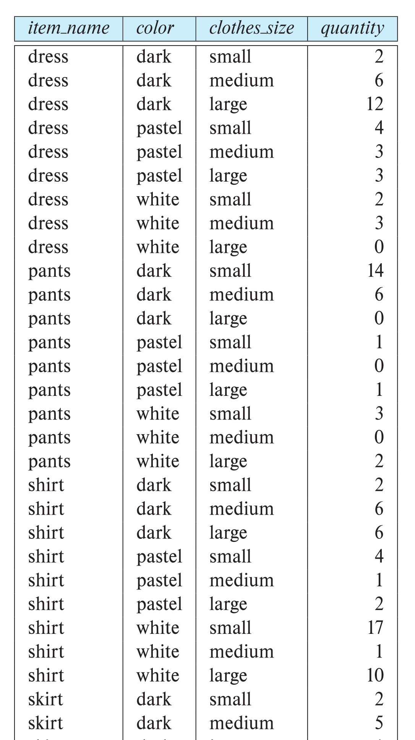
Example sales relation
...
...
...
...
...
...
...
...

Slide 70
Cross Tabulation of sales by item_name and color
The table above is an example of a cross-tabulation (cross-tab), also referred to as a pivot-table.
Values for one of the dimension attributes form the row headers
Values for another dimension attribute form the column headers
Other dimension attributes are listed on top
Values in individual cells are (aggregates of) the values of the dimension attributes that specify the cell.

Slide 71
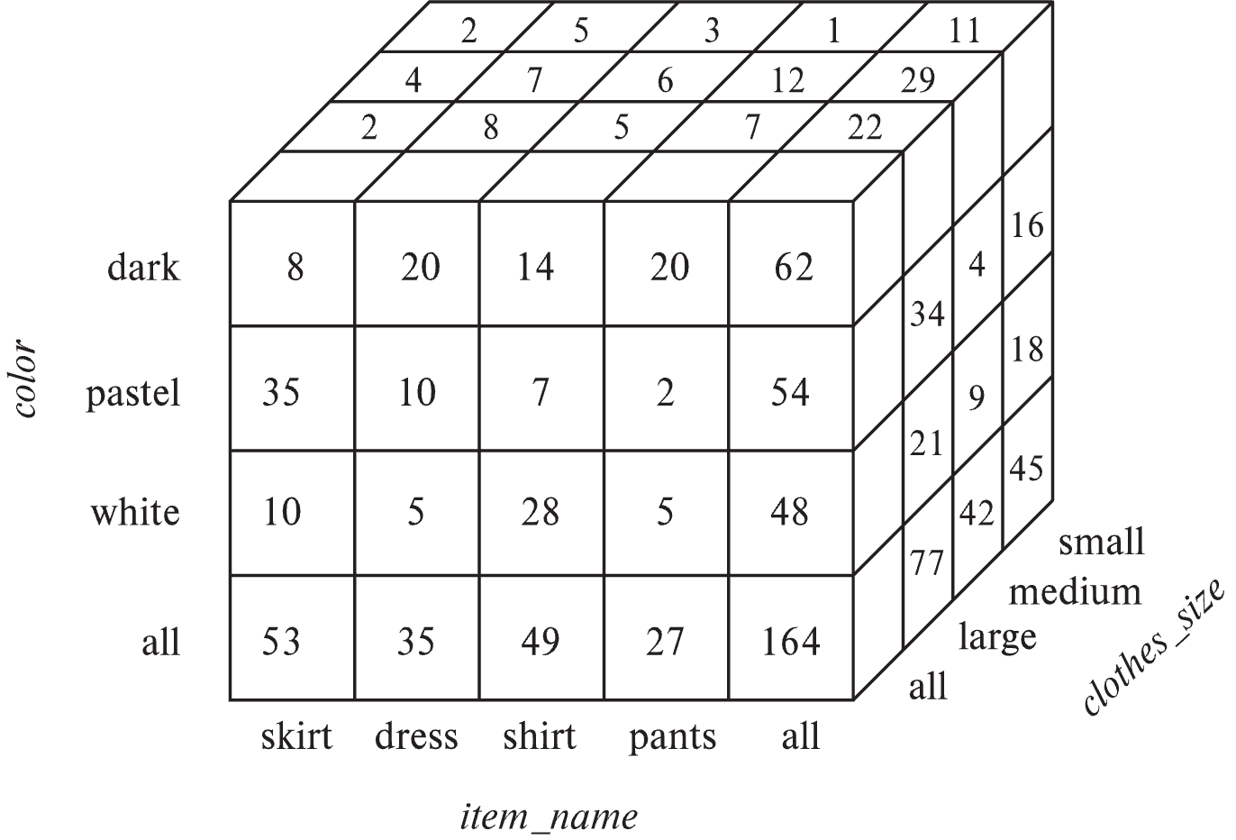
Data Cube
A data cube is a multidimensional generalization of a cross-tab
Can have n dimensions; we show 3 below
Cross-tabs can be used as views on a data cube

Slide 72
Online Analytical Processing Operations
Pivoting: changing the dimensions used in a cross-tab
E.g., moving colors to column names
Slicing: creating a cross-tab for fixed values only
E.g., fixing color to white and size to small
Sometimes called dicing, particularly when values for multiple dimensions are fixed.
Rollup: moving from finer-granularity data to a coarser granularity
E.g., aggregating away an attribute
E.g., moving from aggregates by day to aggregates by month or year
Drill down: The opposite operation - that of moving from coarser-granularity data to finer-granularity data

Slide 73
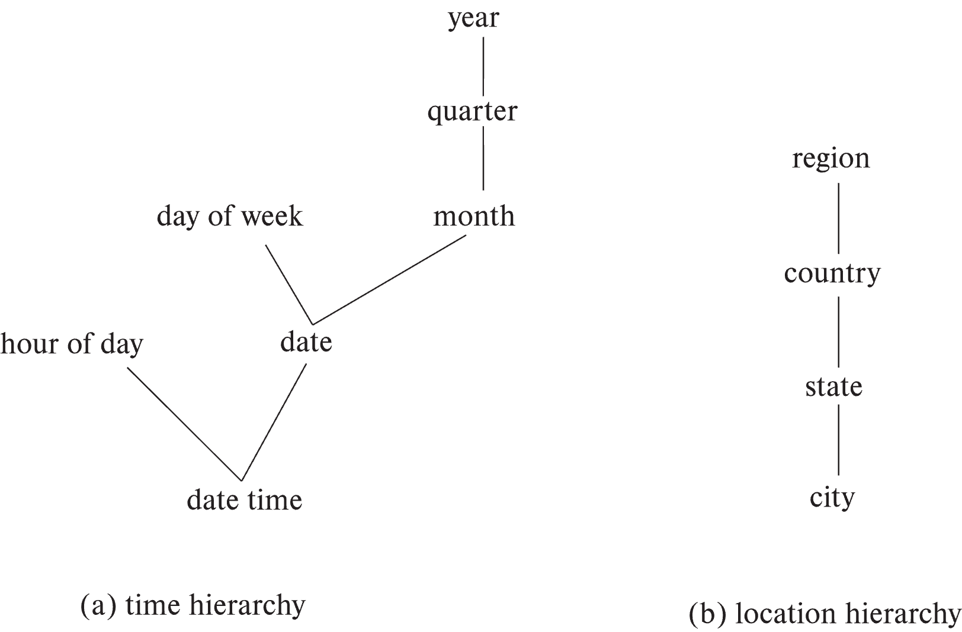
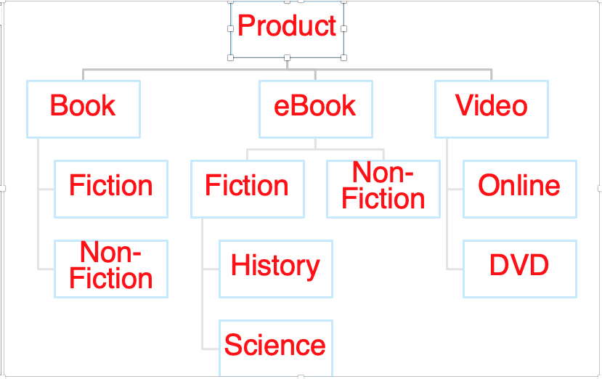
Hierarchies on Dimensions
Hierarchy on dimension attributes: lets dimensions be viewed at different levels of detail
E.g., the dimension datetime can be used to aggregate by hour of day, date, day of week, month, quarter or year
Another dimension could be ... Product category.

Slide 74
Another Dimension Example – Product Categories
Product
Book
eBook
Video
Fiction
Non-Fiction
Non-
Fiction
Fiction
Online
DVD
History
Science

Slide 75
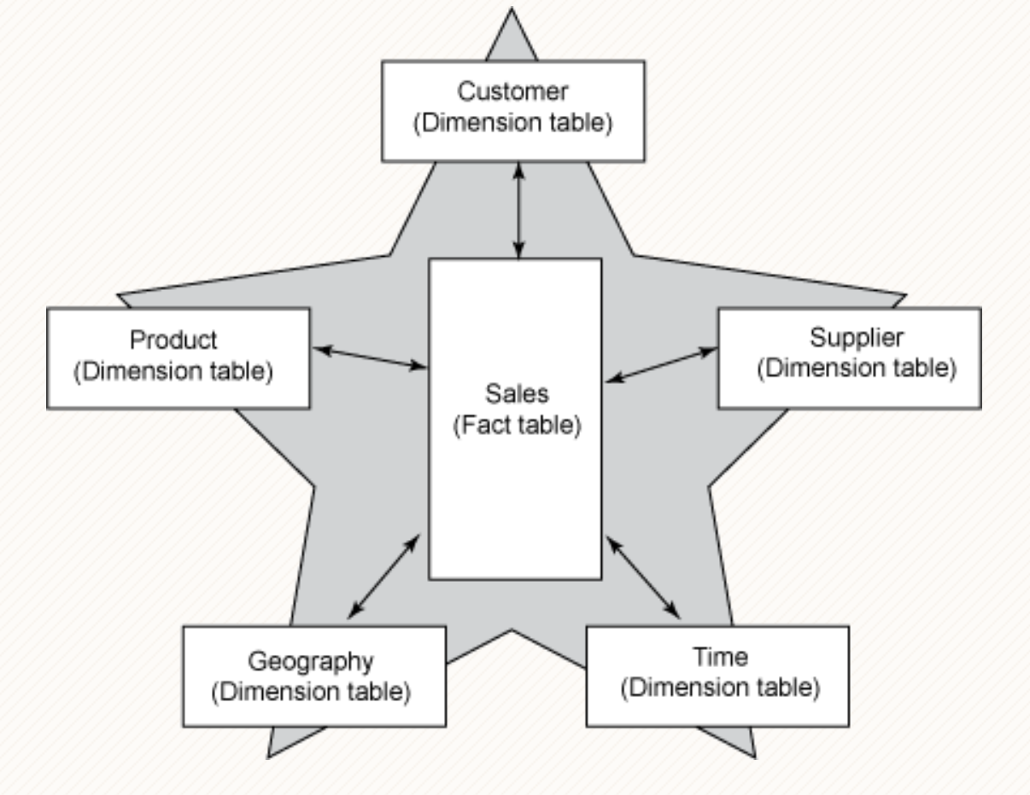
Facts and Dimensions

Slide 76
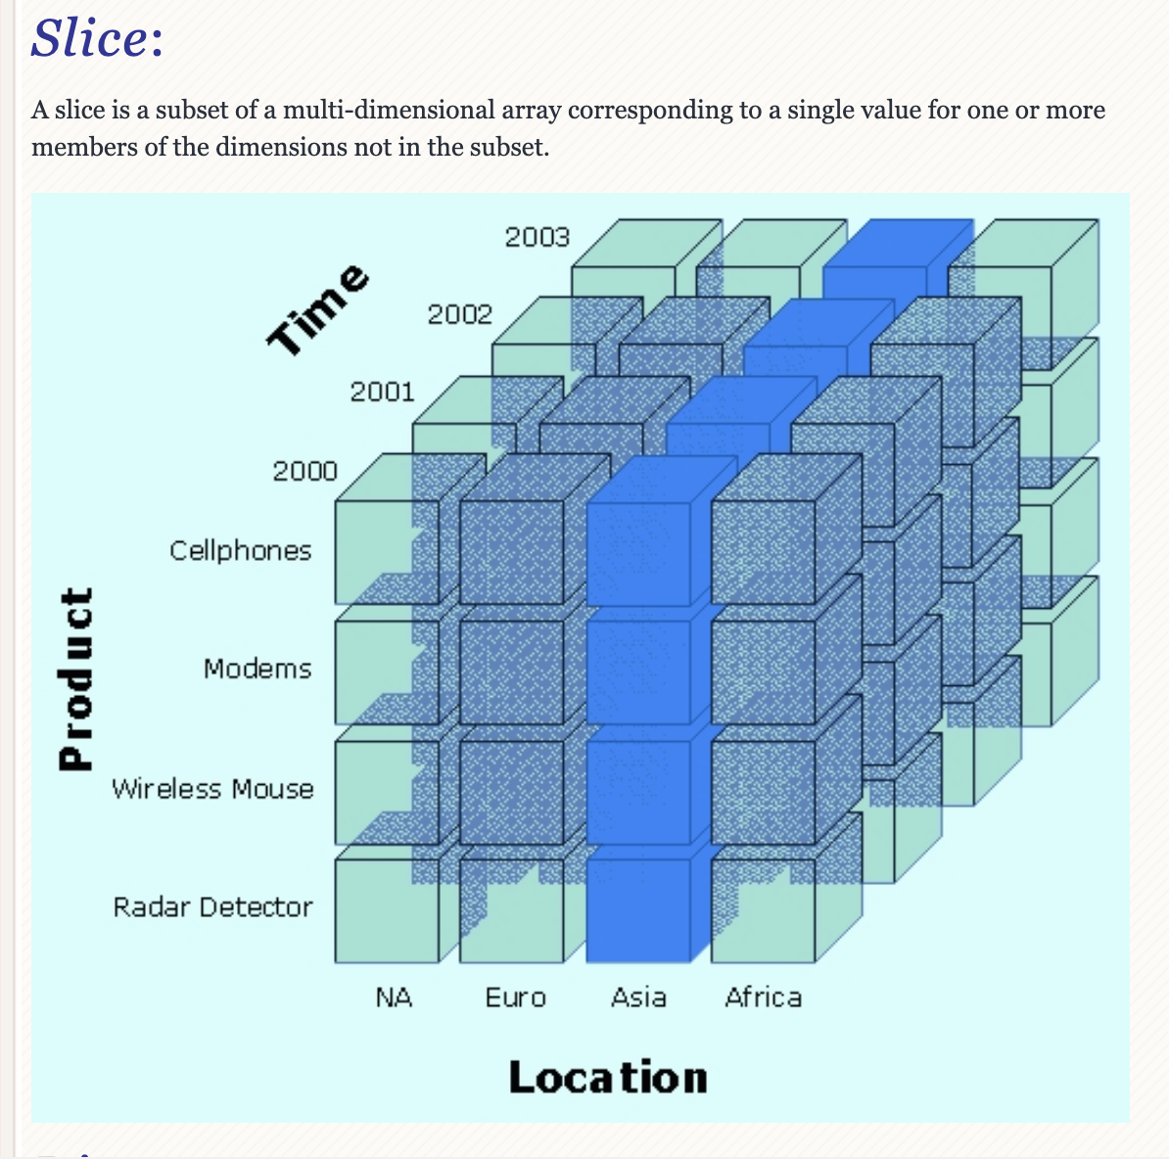
Slice

Slide 77
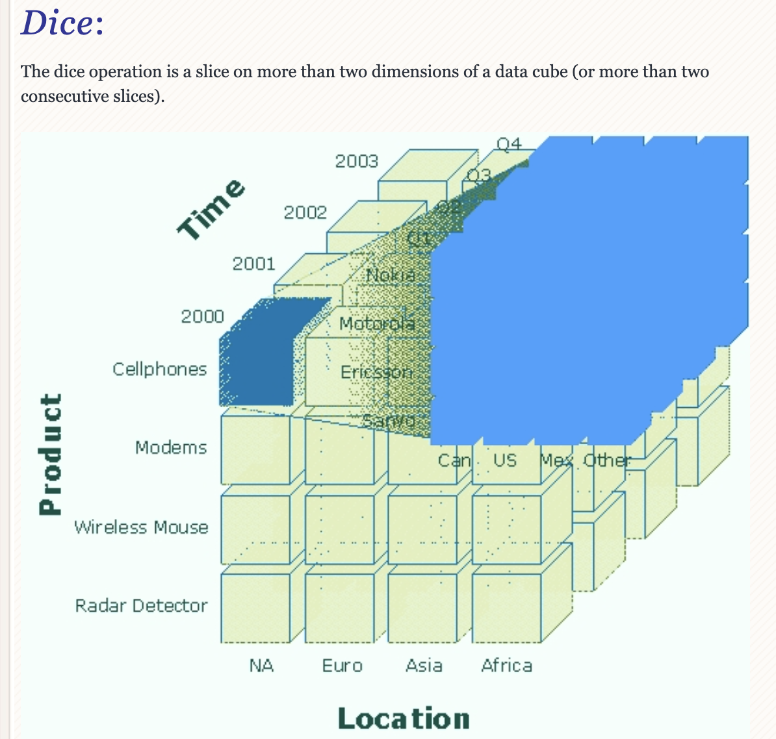
Dice

Slide 78
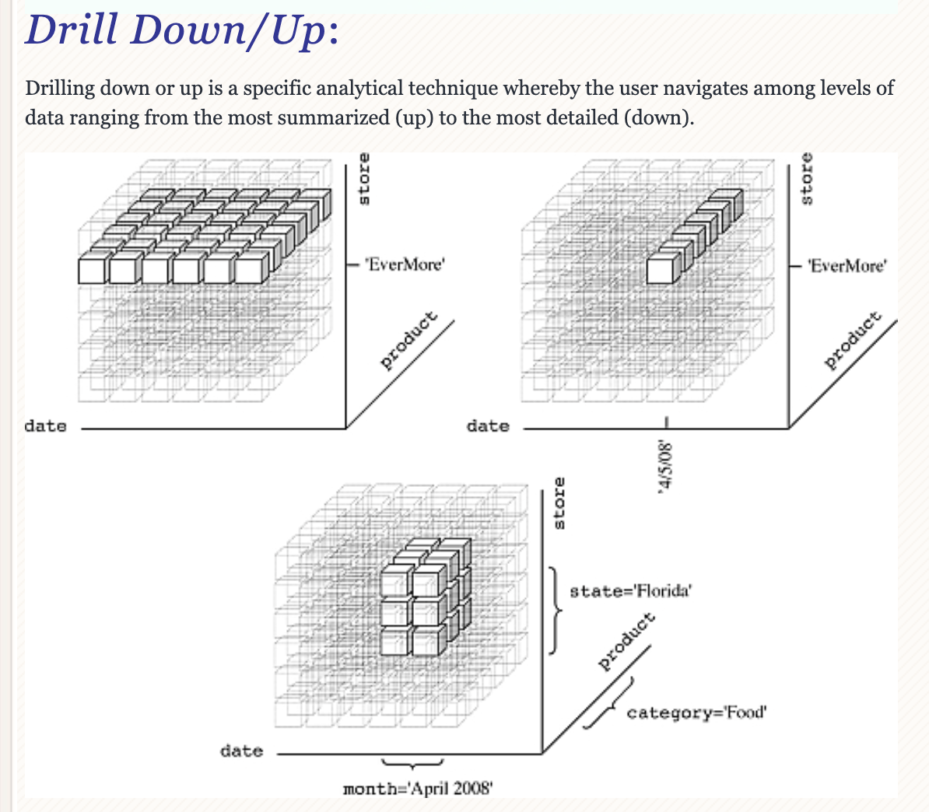
Drilling

Slide 79
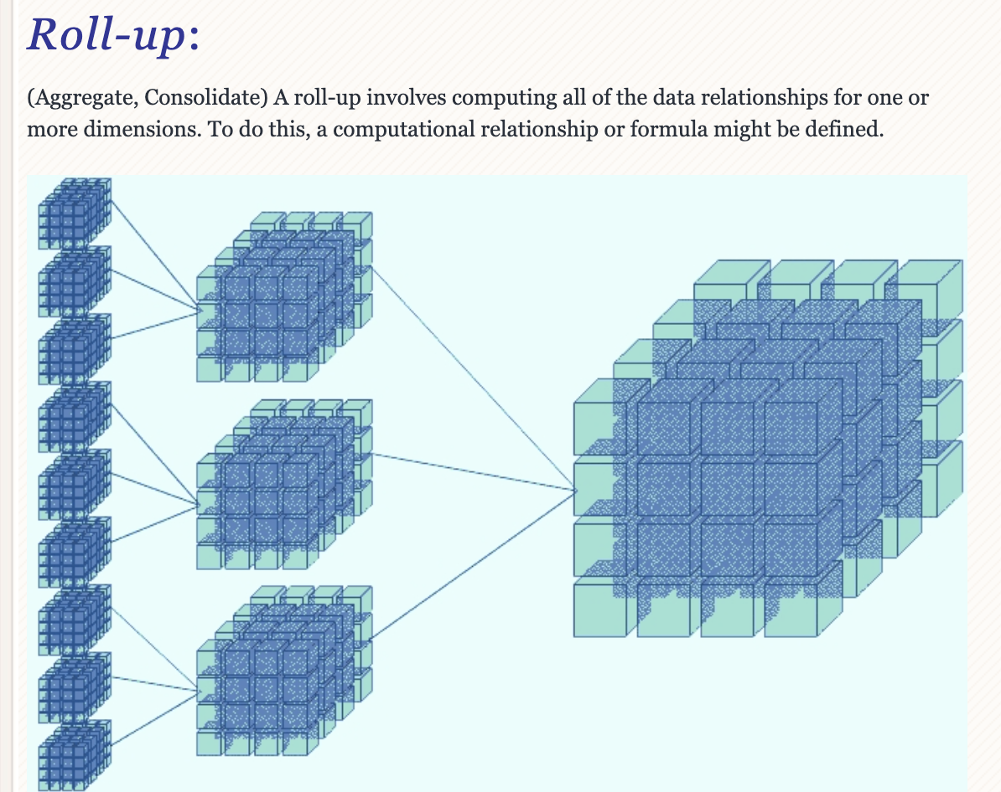
Roll-up

Slide 80
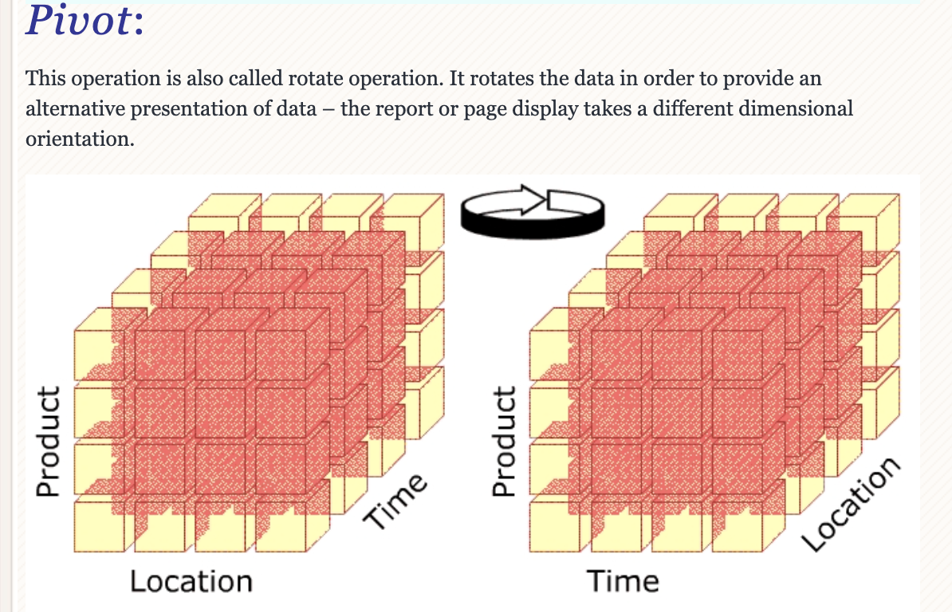
Pivot

Slide 81
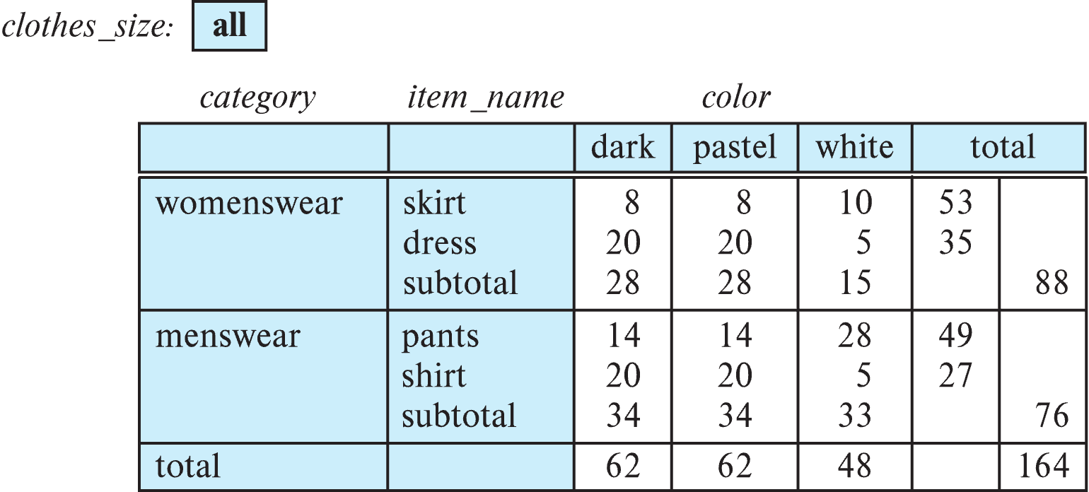
Cross Tabulation With Hierarchy
Cross-tabs can be easily extended to deal with hierarchies
Can drill down or roll up on a hierarchy
E.g. hierarchy: item_name → category

Slide 82
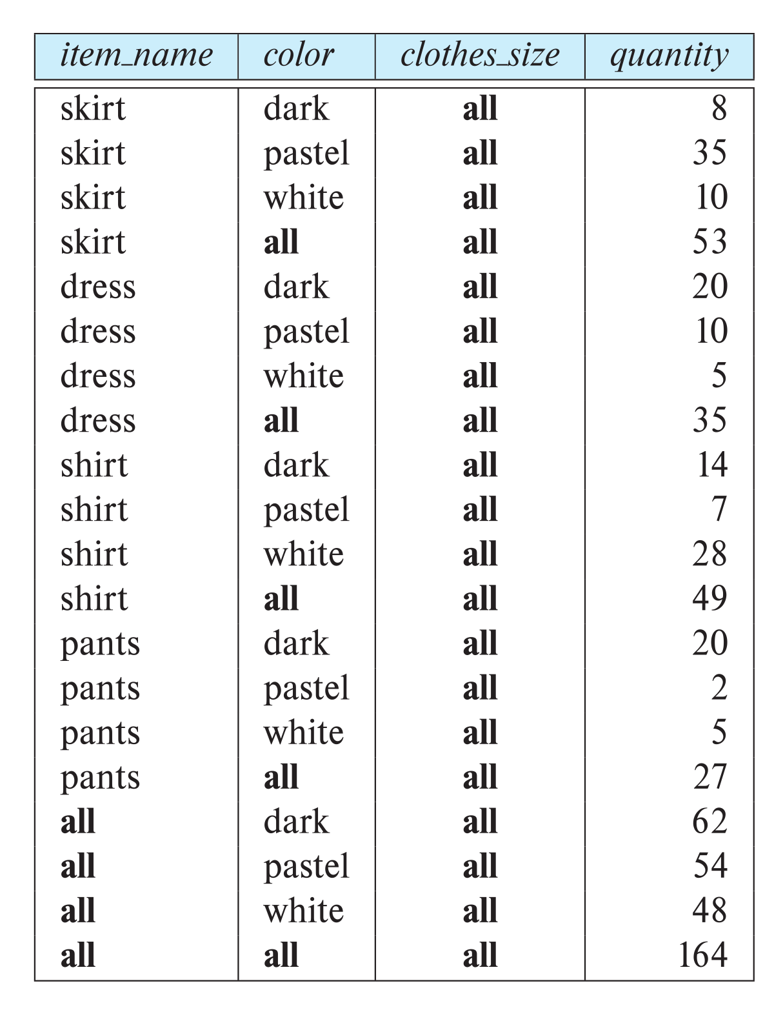
Relational Representation of Cross-tabs
Cross-tabs can be represented as relations
We use the value all to represent aggregates.
The SQL standard actually uses null values in place of all
Works with any data type
But can cause confusion with regular null values.

Slide 83
HW3 and HW4, “The Project” Discussion
83 | W4111-2024F-11-HW3b4b-Normalization-ModuleIV © Donald F. Ferguson, 2024

Slide 84
Overview
84 | W4111-2024F-11-HW3b4b-Normalization-ModuleIV © Donald F. Ferguson, 2024

Slide 85
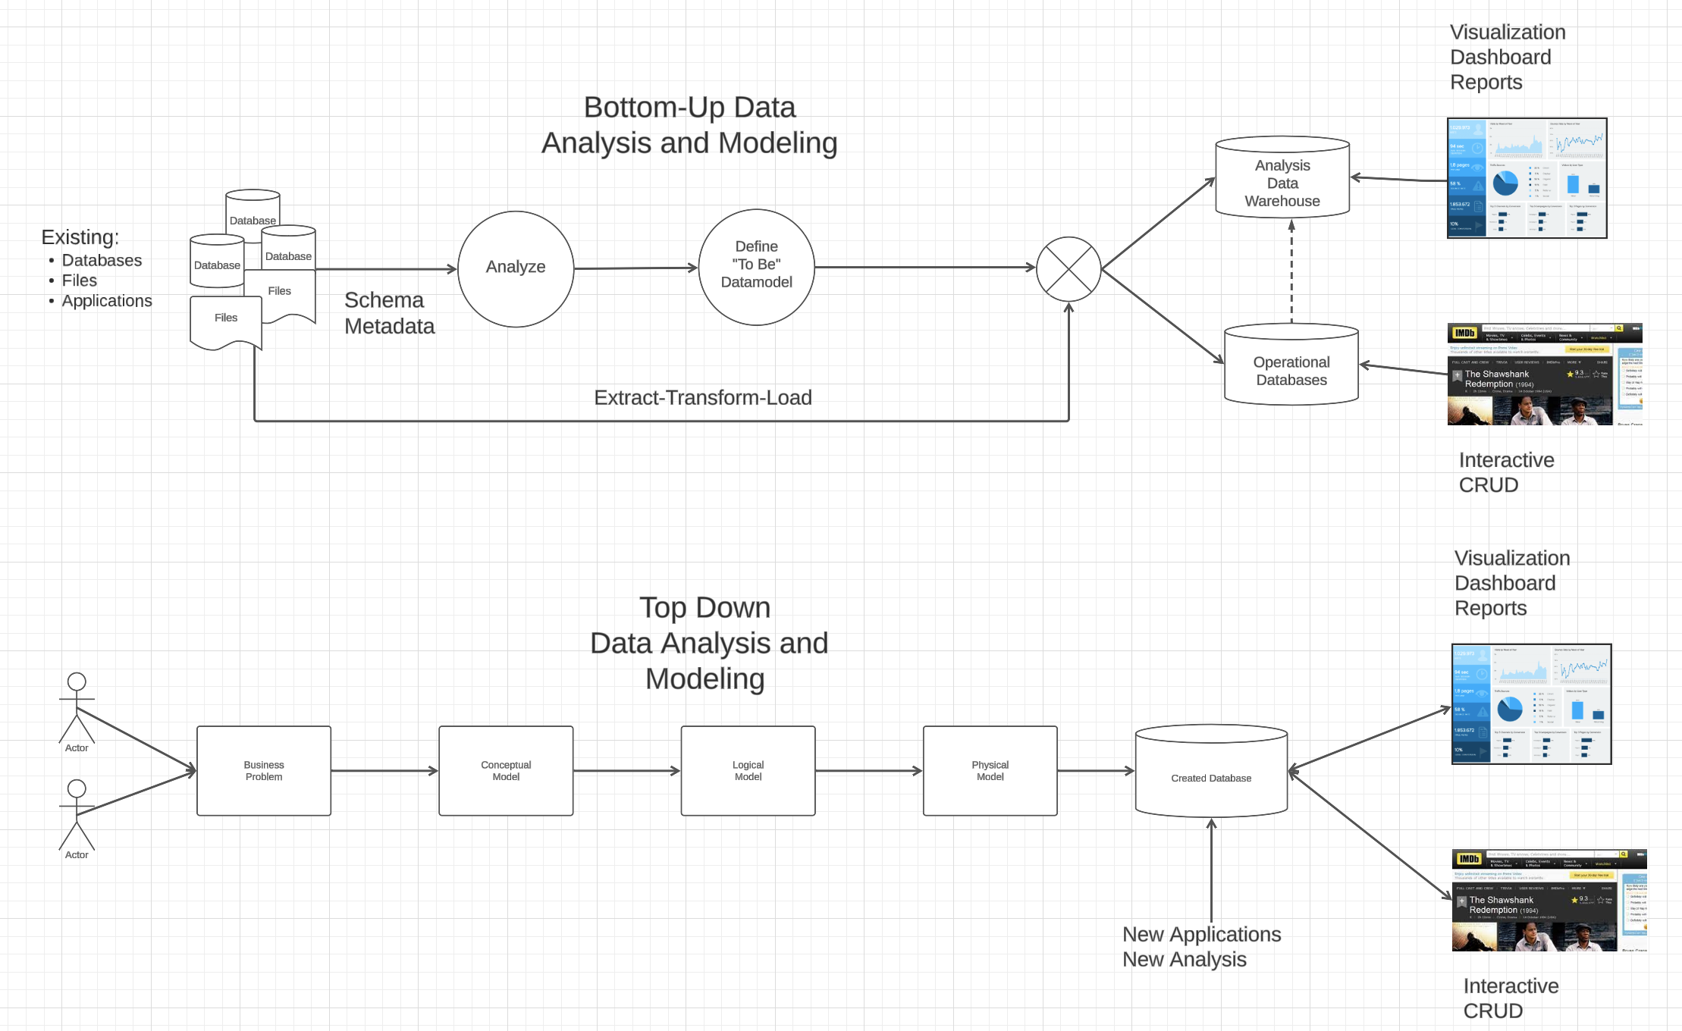
Vision

Slide 86
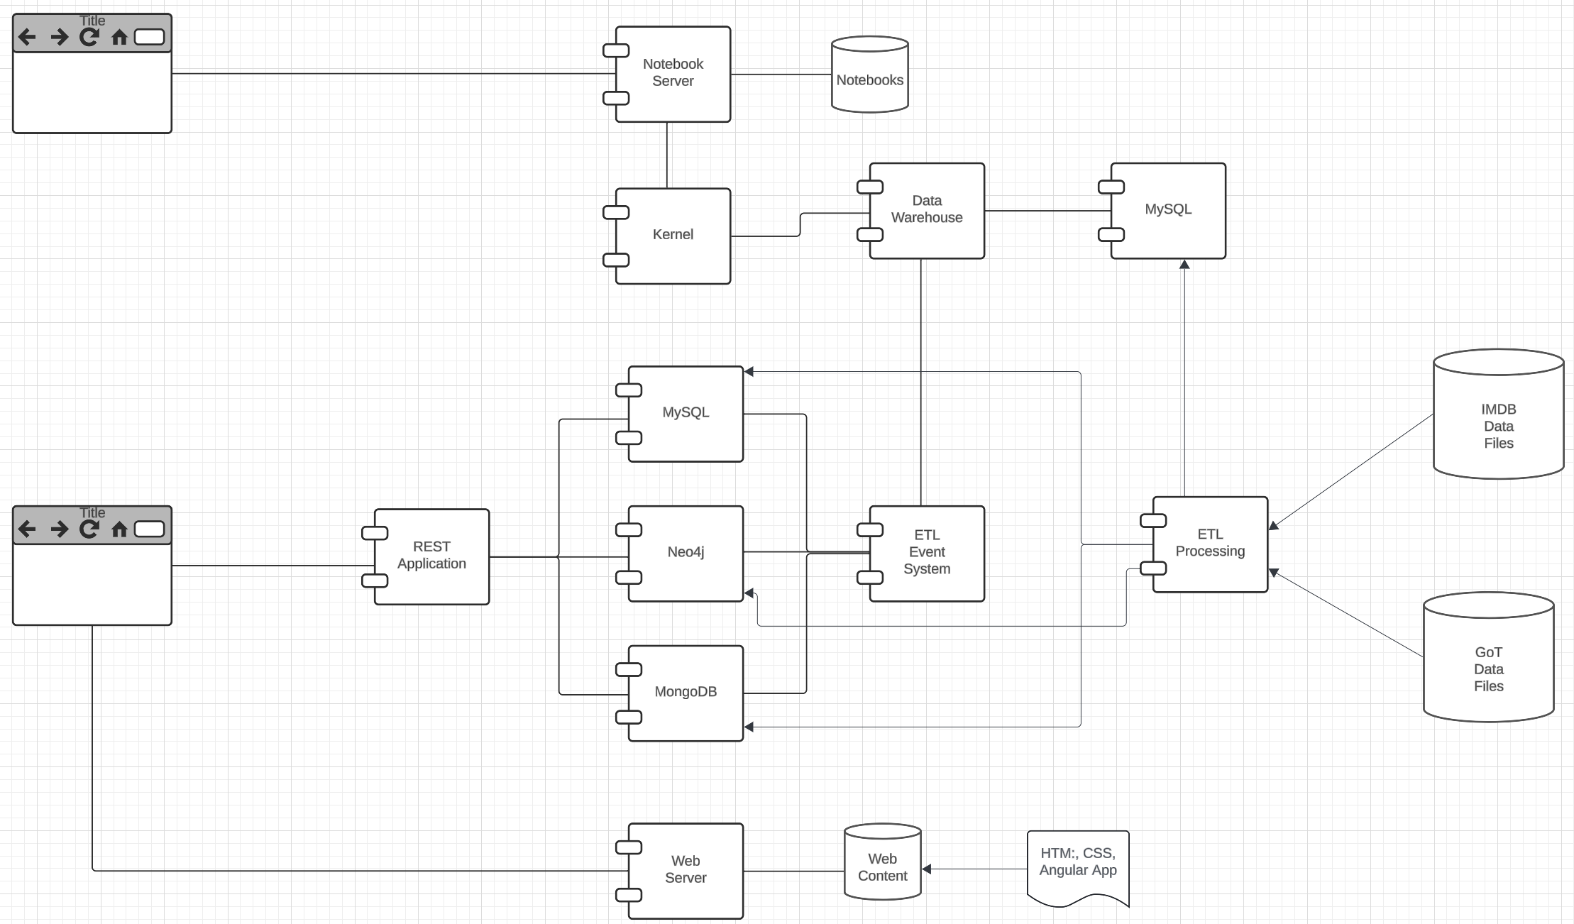
Vision

Slide 87
Vision
Both programming and non-programming implement a data engineering Jupyter notebook.
The programming track builds a simple REST application/microservice for transformed data.
Non-programming implements more complex transformation, and queries for visualization.
I will provide starter projects with examples.

Slide 88
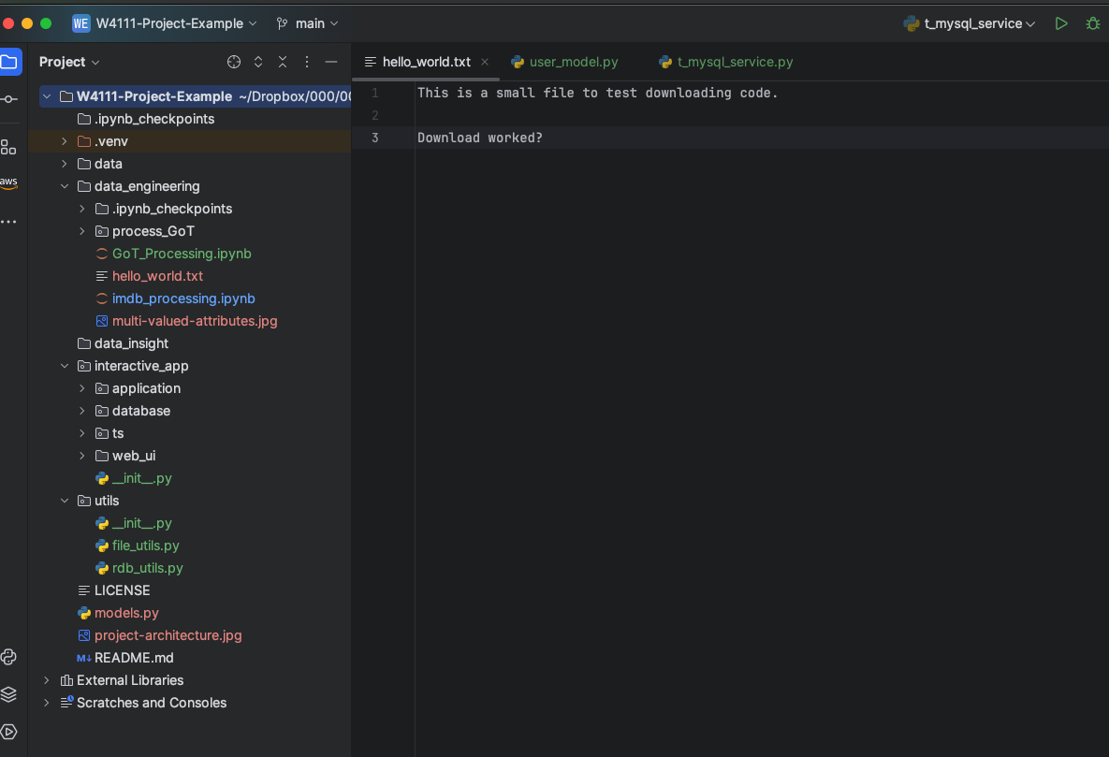
Hw3, HW4 and Project

Slide 89
Hw3, HW4 and Project
Directories for both tracks:
/data contains the input files in CSV and JSON formats
I planned to allow students to choose their own datsets, but this introduces too much complexity. We would have an entire phase of “Is this a goo dataset?”
I will provide simplified IMDB and GoT data.
/data_engineering for initial ETL
/data_insight contains more complex queries and visualization for the non-programming track.
/interactive_application contains a simple web UI, REST application template and database schema for the programming tracks

Slide 90
REST
90 | W4111-2024F-11-HW3b4b-Normalization-ModuleIV © Donald F. Ferguson, 2024

Slide 91
Data Modeling Concepts and REST
Almost any data model has the same core concepts:
Types and instances:
Entity Type: A definition of a type of thing with properties and relationships.
Entity Instance: A specific instantiation of the Entity Type
Entity Set Instance: An Entity Type that:
Has properties and relationships like any entity, but ...
Has at least one special relationship – contains.
Operations, minimally CRUD, that manipulate entity types and instances:
Create
Retrieve
Update
Delete
Reference/Identify/... ...
Host/database/table/pk

Slide 92
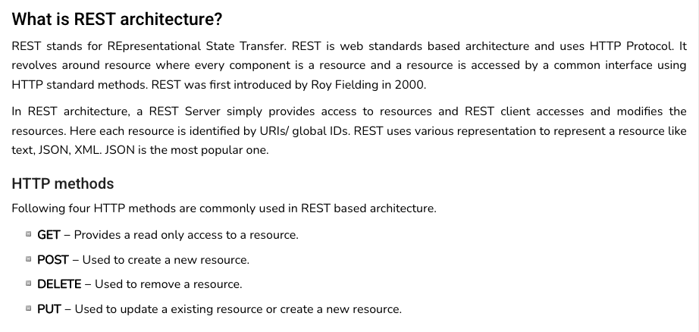
REST (https://www.tutorialspoint.com/restful/restful_introduction.htm)

Slide 93
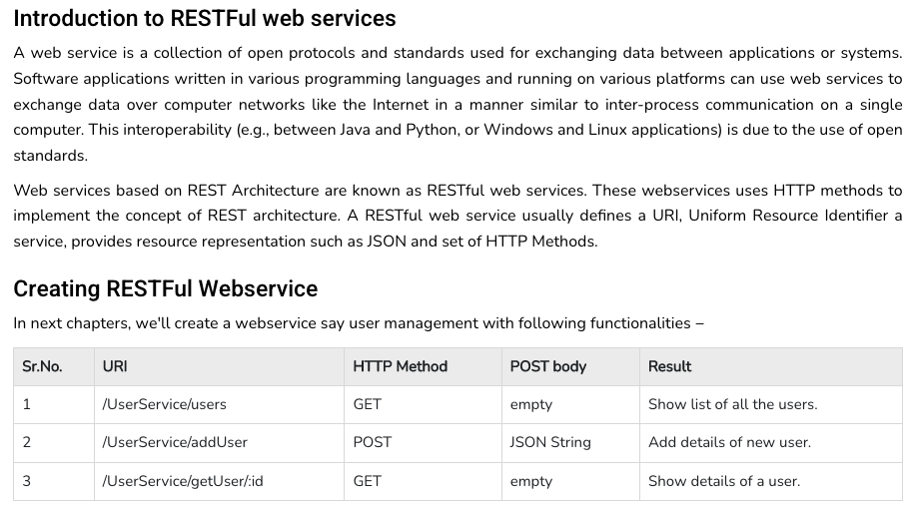
REST (https://www.tutorialspoint.com/restful/restful_introduction.htm)

Slide 94
REST and Resources

Slide 95
URLs

Slide 96
jdbc:mysql://columbia-examples.ckkqqktwkcji.us-east-1.rds.amazonaws.com:3306
GET http://localhost:5001/f23_imdb_clean/name_basics/nm0000158
GET http://localhost:5001/f23_imdb_clean/name_basics?deathYear=2023&birthyear=1960
select * from f23_imdb_clean.name_basics where
deathYear=2023 AND birthyear=1960
PUT http://localhost:5001/f23_imdb_clean/name_basics ?deathYear=2023&birthyear=1960
Body {‘primaryName’: ‘Does not matter cause is dead.’}
update f23_imdb_clean.name_basics
set
where deathYear=2023 AND birthyear=1960

Slide 97
Locking Reference Material
97 | W4111-2024F-11-HW3b4b-Normalization-ModuleIV © Donald F. Ferguson, 2024

Slide 98
Lock-Based Protocols
A lock is a mechanism to control concurrent access to a data item
Data items can be locked in two modes :
1. exclusive (X) mode. Data item can be both read as well as
written. X-lock is requested using lock-X instruction.
2. shared (S) mode. Data item can only be read. S-lock is
requested using lock-S instruction.
Lock requests are made to concurrency-control manager. Transaction can proceed only after request is granted.

Slide 99
Lock-Based Protocols (Cont.)
Lock-compatibility matrix
A transaction may be granted a lock on an item if the requested lock is compatible with locks already held on the item by other transactions
Any number of transactions can hold shared locks on an item,
But if any transaction holds an exclusive on the item no other transaction may hold any lock on the item.
Notes:
If a lock cannot be granted, the requesting transaction is made to wait till all incompatible locks held by other transactions have been released. The lock is then granted.

Slide 100
Lock-Based Protocols (Cont.)
Example of a transaction performing locking:
T₂: lock-S(A);
read (A);
unlock(A);
lock-S(B);
read (B);
unlock(B);
display(A+B)
Locking as above is not sufficient to guarantee serializability

Slide 101
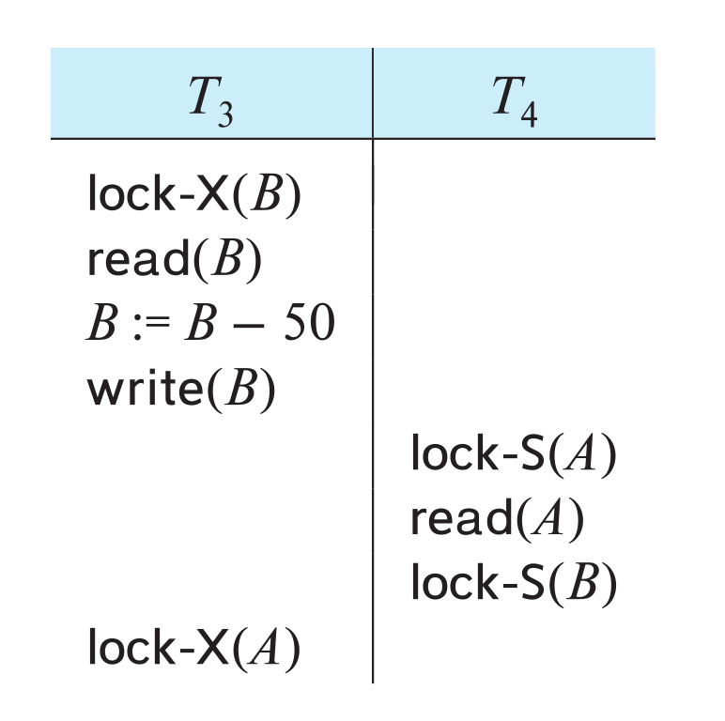
Deadlock
Consider the partial schedule
Neither T₃ nor T₄ can make progress — executing lock-S(B) causes T₄ to wait for T₃ to release its lock on B, while executing lock-X(A) causes T₃ to wait for T₄ to release its lock on A.
Such a situation is called a deadlock.
To handle a deadlock one of T₃ or T₄ must be rolled back and its locks released.

Slide 102
Deadlock (Cont.)
The potential for deadlock exists in most locking protocols. Deadlocks are a necessary evil.
Starvation is also possible if concurrency control manager is badly designed. For example:
A transaction may be waiting for an X-lock on an item, while a sequence of other transactions request and are granted an S-lock on the same item.
The same transaction is repeatedly rolled back due to deadlocks.
Concurrency control manager can be designed to prevent starvation.

Slide 103
The Two-Phase Locking Protocol
A protocol which ensures conflict-serializable schedules.
Phase 1: Growing Phase
Transaction may obtain locks
Transaction may not release locks
Phase 2: Shrinking Phase
Transaction may release locks
Transaction may not obtain locks
The protocol assures serializability. It can be proved that the transactions can be serialized in the order of their lock points (i.e., the point where a transaction acquired its final lock).
Locks
Time

Slide 104
The Two-Phase Locking Protocol (Cont.)
Two-phase locking does not ensure freedom from deadlocks
Extensions to basic two-phase locking needed to ensure recoverability of freedom from cascading roll-back
Strict two-phase locking: a transaction must hold all its exclusive locks till it commits/aborts.
Ensures recoverability and avoids cascading roll-backs
Rigorous two-phase locking: a transaction must hold all locks till commit/abort.
Transactions can be serialized in the order in which they commit.
Most databases implement rigorous two-phase locking, but refer to it as simply two-phase locking

Slide 105
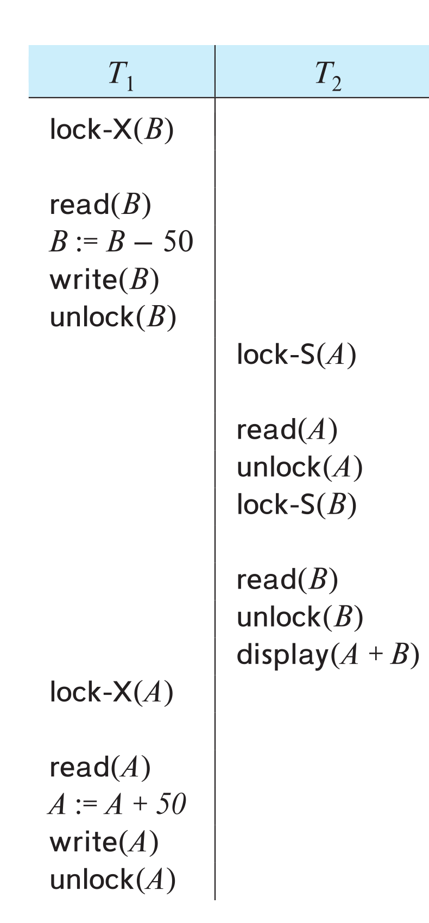
The Two-Phase Locking Protocol (Cont.)
Two-phase locking is not a necessary condition for serializability
There are conflict serializable schedules that cannot be obtained if the two-phase locking protocol is used.
In the absence of extra information (e.g., ordering of access to data), two-phase locking is necessary for conflict serializability in the following sense:
Given a transaction T_{i} that does not follow two-phase locking, we can find a transaction T_{j} that uses two-phase locking, and a schedule for T_{i} and T_{j} that is not conflict serializable.

Slide 106
Locking Protocols
Given a locking protocol (such as 2PL)
A schedule S is legal under a locking protocol if it can be generated by a set of transactions that follow the protocol
A protocol ensures serializability if all legal schedules under that protocol are serializable

Slide 107
Lock Conversions
Two-phase locking protocol with lock conversions:
– Growing Phase:
can acquire a lock-S on item
can acquire a lock-X on item
can convert a lock-S to a lock-X (upgrade)
– Shrinking Phase:
can release a lock-S
can release a lock-X
can convert a lock-X to a lock-S (downgrade)
This protocol ensures serializability

Slide 108
Automatic Acquisition of Locks
A transaction T_{i} issues the standard read/write instruction, without explicit locking calls.
The operation read(D) is processed as:
if T_{i} has a lock on D
then
read(D)
else begin
if necessary wait until no other
transaction has a lock-X on D
grant T_{i} a lock-S on D;
read(D)
end

Slide 109
Automatic Acquisition of Locks (Cont.)
The operation write(D) is processed as:
if T_{i} has a lock-X on D
then
write(D)
else begin
if necessary wait until no other trans. has any lock on D,
if T_{i} has a lock-S on D
then
upgrade lock on D to lock-X
else
grant T_{i} a lock-X on D
write(D)
end;
All locks are released after commit or abort

Slide 110
Implementation of Locking
A lock manager can be implemented as a separate process
Transactions can send lock and unlock requests as messages
The lock manager replies to a lock request by sending a lock grant messages (or a message asking the transaction to roll back, in case of a deadlock)
The requesting transaction waits until its request is answered
The lock manager maintains an in-memory data-structure called a lock table to record granted locks and pending requests

Slide 111
Deadlock Handling
System is deadlocked if there is a set of transactions such that every transaction in the set is waiting for another transaction in the set.

Slide 112
Deadlock Handling
Deadlock prevention protocols ensure that the system will never enter into a deadlock state. Some prevention strategies:
Require that each transaction locks all its data items before it begins execution (pre-declaration).
Impose partial ordering of all data items and require that a transaction can lock data items only in the order specified by the partial order (graph-based protocol).

Slide 113
More Deadlock Prevention Strategies
wait-die scheme — non-preemptive
Older transaction may wait for younger one to release data item.
Younger transactions never wait for older ones; they are rolled back instead.
A transaction may die several times before acquiring a lock
wound-wait scheme — preemptive
Older transaction wounds (forces rollback) of younger transaction instead of waiting for it.
Younger transactions may wait for older ones.
Fewer rollbacks than wait-die scheme.
In both schemes, a rolled back transactions is restarted with its original timestamp.
Ensures that older transactions have precedence over newer ones, and starvation is thus avoided.

Slide 114
Deadlock prevention (Cont.)
Timeout-Based Schemes:
A transaction waits for a lock only for a specified amount of time. After that, the wait times out and the transaction is rolled back.
Ensures that deadlocks get resolved by timeout if they occur
Simple to implement
But may roll back transaction unnecessarily in absence of deadlock
Difficult to determine good value of the timeout interval.
Starvation is also possible

Slide 115
Deadlock Detection
Wait-for graph
Vertices: transactions
Edge from T_{i} →T_{j}. : if T_{i} is waiting for a lock held in conflicting mode byT_{j}
The system is in a deadlock state if and only if the wait-for graph has a cycle.
Invoke a deadlock-detection algorithm periodically to look for cycles.
Wait-for graph without a cycle
Wait-for graph with a cycle

Slide 116
Deadlock Recovery
When deadlock is detected :
Some transaction will have to rolled back (made a victim) to break deadlock cycle.
Select that transaction as victim that will incur minimum cost
Rollback -- determine how far to roll back transaction
Total rollback: Abort the transaction and then restart it.
Partial rollback: Roll back victim transaction only as far as necessary to release locks that another transaction in cycle is waiting for
Starvation can happen (why?)
One solution: oldest transaction in the deadlock set is never chosen as victim

Slide 117
Schedules, Serializable
Transactions Isolation Recovery

Slide 118
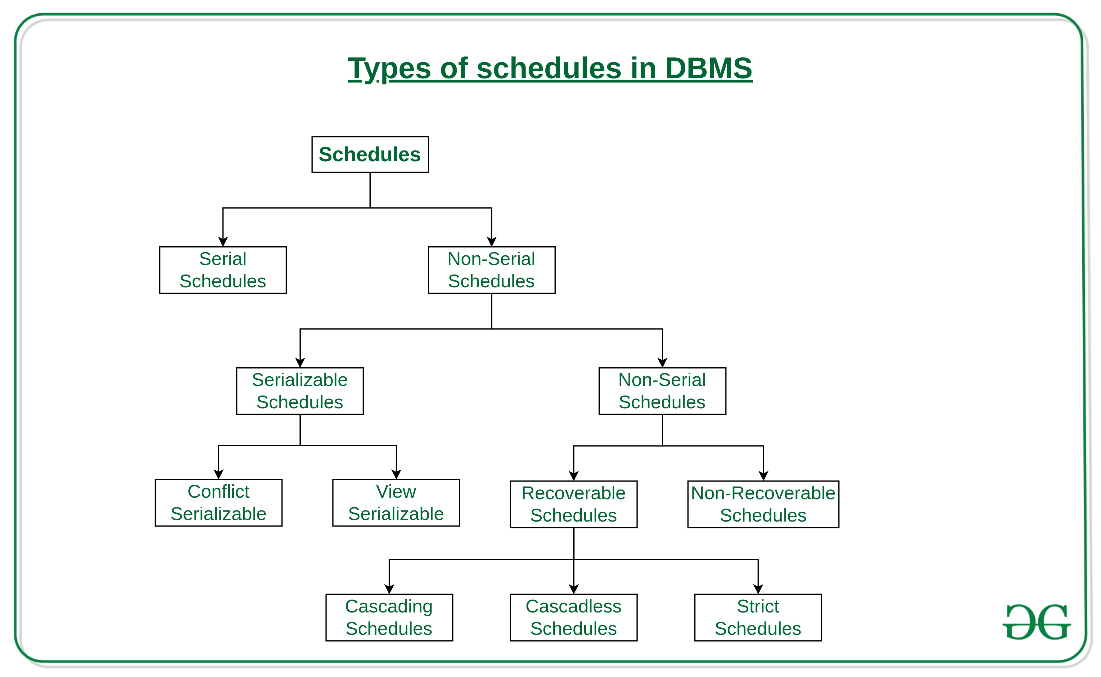
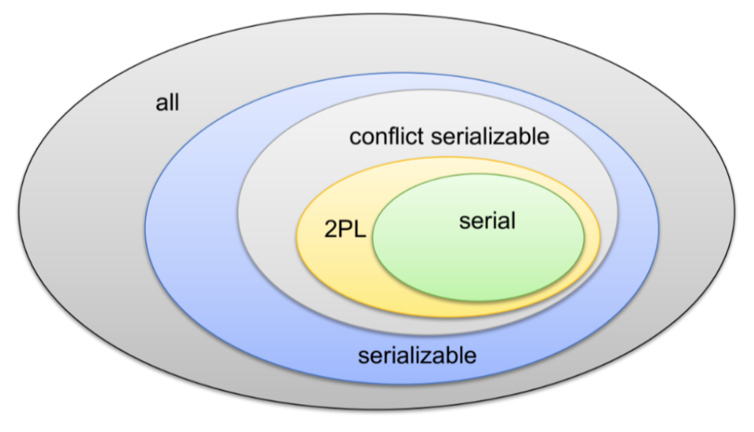
Schedules and Serializable
We covered serial schedules, 2PL and serializable in the previous lecture.
The types of schedules are much more complex.
There are also forms of conflict management and lock types other than R/W.
We will talk a little bit about them for awareness.
These are academically interesting but do not come up in practice.

Slide 119
Serializability
Basic Assumption – Each transaction preserves database consistency.
Thus, serial execution of a set of transactions preserves database consistency.
A (possibly concurrent) schedule is serializable if it is equivalent to a serial schedule. Different forms of schedule equivalence give rise to the notions of:
1. Conflict serializability
2. View serializability

Slide 120
Simplified view of transactions
We ignore operations other than read and write instructions
We assume that transactions may perform arbitrary computations on data in local buffers in between reads and writes.
Our simplified schedules consist of only read and write instructions.

Slide 121
Conflicting Instructions
Instructions l_{i} and l_{j} of transactions T_{i} and T_{j} respectively, conflict if and only if there exists some item Q accessed by both l_{i} and l_{j}, and at least one of these instructions wrote Q.
1. l_{i} = read(Q), l_{j} = read(Q). l_{i} and l_{j} don’t conflict. 2. l_{i} = read(Q), l_{j} = write(Q). They conflict. 3. l_{i} = write(Q), l_{j} = read(Q). They conflict 4. l_{i} = write(Q), l_{j} = write(Q). They conflict
Intuitively, a conflict between l_{i} and l_{j} forces a (logical) temporal order between them.
If l_{i} and l_{j} are consecutive in a schedule and they do not conflict, their results would remain the same even if they had been interchanged in the schedule.

Slide 122
Conflict Serializability
If a schedule S can be transformed into a schedule S’ by a series of swaps of non-conflicting instructions, we say that S and S’ are conflict equivalent.
We say that a schedule S is conflict serializable if it is conflict equivalent to a serial schedule

Slide 123
Conflict Serializability (Cont.)
Schedule 3 can be transformed into Schedule 6, a serial schedule where T₂ follows T₁, by series of swaps of non-conflicting instructions. Therefore Schedule 3 is conflict serializable.
Schedule 3
Schedule 6

Slide 124
Conflict Serializability (Cont.)
Example of a schedule that is not conflict serializable:
We are unable to swap instructions in the above schedule to obtain either the serial schedule < T₃, T₄ >, or the serial schedule < T₄, T₃ >.

Slide 125
View Serializability
Let S and S’ be two schedules with the same set of transactions. S and S’ are view equivalent if the following three conditions are met, for each data item Q,
1. If in schedule S, transaction T_{i} reads the initial value of Q, then in
schedule S’ also transaction T_{i} must read the initial value of Q.
2. If in schedule S transaction T_{i} executes read(Q), and that value was
produced by transaction T_{j} (if any), then in schedule S’ also
transaction T_{i} must read the value of Q that was produced by the
same write(Q) operation of transaction T_{j} .
3. The transaction (if any) that performs the final write(Q) operation in
schedule S must also perform the final write(Q) operation in schedule S’.
As can be seen, view equivalence is also based purely on reads and writes alone.

Slide 126
View Serializability (Cont.)
A schedule S is view serializable if it is view equivalent to a serial schedule.
Every conflict serializable schedule is also view serializable.
Below is a schedule which is view-serializable but not conflict serializable.
What serial schedule is above equivalent to?
Every view serializable schedule that is not conflict serializable has blind writes.

Slide 127
Testing for Serializability
Consider some schedule of a set of transactions T₁, T₂, ..., T_{n}
Precedence graph — a direct graph where the vertices are the transactions (names).
We draw an arc from T_{i} to T_{j} if the two transaction conflict, and T_{i} accessed the data item on which the conflict arose earlier.
We may label the arc by the item that was accessed.
Example of a precedence graph

Slide 128
Test for Conflict Serializability
A schedule is conflict serializable if and only if its precedence graph is acyclic.
Cycle-detection algorithms exist which take order n² time, where n is the number of vertices in the graph.
(Better algorithms take order n + e where e is the number of edges.)
If precedence graph is acyclic, the serializability order can be obtained by a topological sorting of the graph.
This is a linear order consistent with the partial order of the graph.
For example, a serializability order for Schedule A would be T₅ → T₁ → T₃ → T₂ → T₄
Are there others?

Slide 129
Recoverable Schedules
Need to address the effect of transaction failures on concurrently running transactions.
Recoverable schedule — if a transaction T_{j} reads a data item previously written by a transaction T_{i} , then the commit operation of T_{i} appears before the commit operation of T_{j}.
The following schedule (Schedule 11) is not recoverable
If T₈ should abort, T₉ would have read (and possibly shown to the user) an inconsistent database state. Hence, database must ensure that schedules are recoverable.

Slide 130
Cascading Rollbacks
Cascading rollback – a single transaction failure leads to a series of transaction rollbacks. Consider the following schedule where none of the transactions has yet committed (so the schedule is recoverable) If T₁₀ fails, T₁₁ and T₁₂ must also be rolled back.
Can lead to the undoing of a significant amount of work

Slide 131
Concurrency Control vs. Serializability Tests
Concurrency-control protocols allow concurrent schedules, but ensure that the schedules are conflict/view serializable, and are recoverable and cascadeless .
Concurrency control protocols (generally) do not examine the precedence graph as it is being created
Instead a protocol imposes a discipline that avoids non-serializable schedules.
We study such protocols in Chapter 16.
Different concurrency control protocols provide different tradeoffs between the amount of concurrency they allow and the amount of overhead that they incur.
Tests for serializability help us understand why a concurrency control protocol is correct.

Slide 132
Weak Levels of Consistency
Some applications are willing to live with weak levels of consistency, allowing schedules that are not serializable
E.g., a read-only transaction that wants to get an approximate total balance of all accounts
E.g., database statistics computed for query optimization can be approximate (why?)
Such transactions need not be serializable with respect to other transactions
Tradeoff accuracy for performance

Slide 133
Levels of Consistency in SQL-92
Serializable — default
Repeatable read — only committed records to be read.
Repeated reads of same record must return same value.
However, a transaction may not be serializable – it may find some records inserted by a transaction but not find others.
Read committed — only committed records can be read.
Successive reads of record may return different (but committed) values.
Read uncommitted — even uncommitted records may be read.

Slide 134
ACID, CAP, BASE
Transactions Isolation Recovery

Slide 135
BASE
Eventually-consistent services are often classified as providing BASE (Basically Available, Soft state, Eventual consistency) semantics, in contrast to traditional ACID (Atomicity, Consistency, Isolation, Durability) guarantees. Rough definitions of each term in BASE:
Basically Available: basic reading and writing operations are available as much as possible (using all nodes of a database cluster), but without any kind of consistency guarantees (the write may not persist after conflicts are reconciled, the read may not get the latest write)
Soft state: without consistency guarantees, after some amount of time, we only have some probability of knowing the state, since it may not yet have converged
Eventually consistent: If the system is functioning and we wait long enough after any given set of inputs, we will eventually be able to know what the state of the database is, and so any further reads will be consistent with our expectations

Slide 136
ACID – BASE (Simplistic Comparison)
(Or other strategy)

Slide 137
CAP Theorem
Consistency
Every read receives the most recent write or an error.
Availability
Every request receives a (non-error) response – without guarantee that it contains the most recent write.
Partition Tolerance
The system continues to operate despite an arbitrary number of messages being dropped (or delayed) by the network between nodes

Slide 138
Eventual Consistency
Availability and scalability via
Multiple, replicated data stores.
Read goes to “any” replica.
PUT/POST/DELETE
Goes to any replica
Change propagate asynchronously
GET may not see the latest value if the update has not propagated to the replica.
There are several algorithms for conflict resolution
Detect and handle in application.
Clock/change vectors/version numbers
… …
get
put

